Slide 1
Year 2

Slide 2
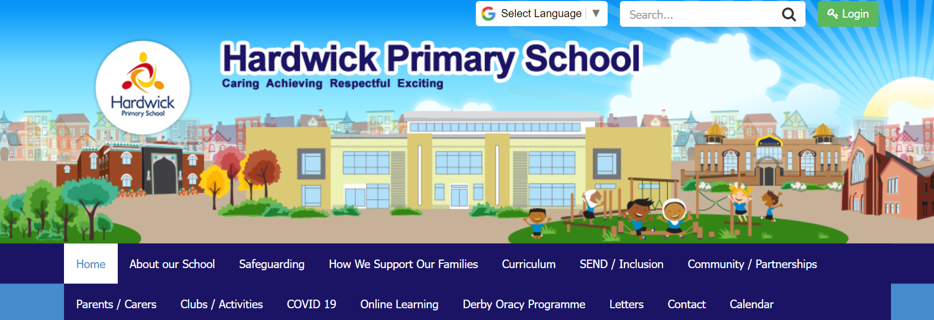
Website -hardwickprimaryschoolderby.co.uk
Click here to go to subjects and year groups

Slide 3
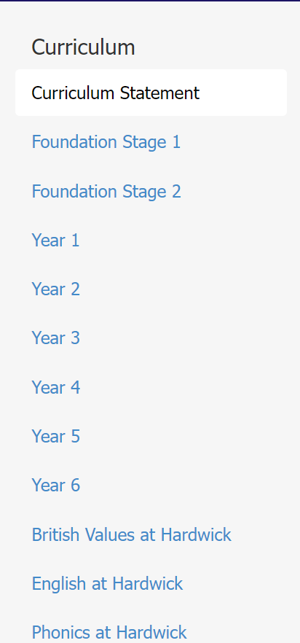

Slide 4
PE days
Mondays and
Wednesdays
Black shorts or joggers/ tracksuit trousers
White t shirt
Trainers
Tracksuit jacket
No ear rings or necklaces

Slide 5
Attendance
We expect children to arrive every day for school.
Gates open in the morning at 8.40 and close at 8.55.
It is important that appointments are made out of school hours as much as possible.
If children have low attendance this can greatly affect their learning and ability to become the best they could be.

Slide 6
Attendance
If your child is ill please phone school in the morning.

Slide 7
Home Learning
Homework is given out on a Friday
It will include a piece of phonics and the maths that they have been covering that week.
Please look through the work with your child.
It then needs to be handed in on the Monday.

Slide 8
Trips
When a trip is organised you will receive notification through WEDUC and have to give permission through Parent Pay. Please do this as quickly as you can.
If you would like to help on a trip please speak to the class teacher so they can organise this if at all possible for you.

Slide 9
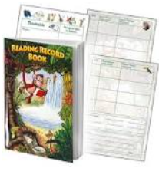
Reading
We ask that you read at least 3 times a week with your child.
Please sign the reading diary.

Slide 10
Maths
During the year we will cover
Place value
Addition and subtraction
Multiplication and division
Time
2D and 3D shapes
Data handling
Money
Mass, length and capacity

Slide 11
English
During the year we will cover
Phonics
Spelling and grammar
Reading comprehension
New vocabulary
Story writing
Recounts
Poetry
Information writing

Slide 12
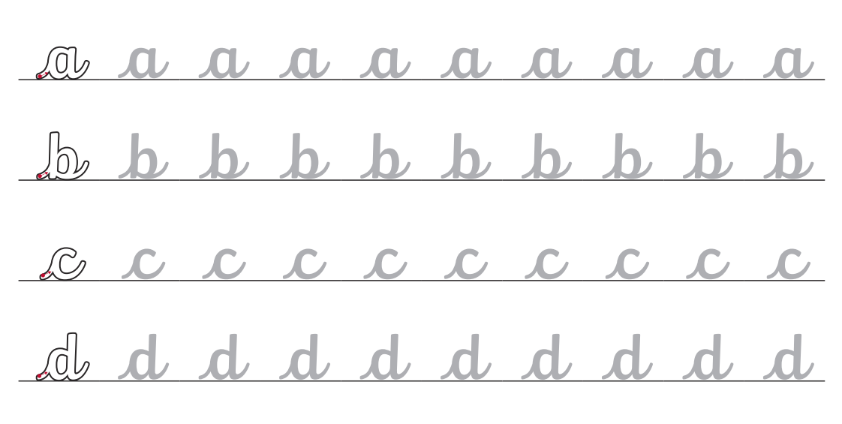
English - handwriting
Joined writing in a cursive style.

Slide 13
Topics

Slide 14
Street Detectives
We learn about the difference between urban and rural.
Using natural objects we create our own pieces of art and discuss them based on Goldsworthy.
In science we discuss different materials and how their properties mean they are used for different things. This includes a science experiment on the materials.

Slide 15
Fire of London
We learn about the fire that destroyed most of London in 1666.
Using paints we learn to create our own warm and cold colours to create a picture of the fire of London.
In science we look at animals and what a food chain is.
During this half term we bake some cakes as this is where the fire is believed to have started.

Slide 16
Humans
This topic is all about what we need to do to keep ourselves healthy.
When trying to keep healthy as well as food we need other things such as sleep and exercise.
In science we look at what sorts of foods we need to eat and how much of each one.
During this half term we will harvest some potatoes that the children will have grown and create a healthy meal that they will get to try.
In music we will be listening to different types of music and saying what we think about them.

Slide 17
Baddies, towers and tunnels
We learn about castles and what it was like to live in a castle.
Using a range of materials we create our own castle that has a moving part on it.
In science we look at animals and building on from the previous learning we look at their habitats and why they live there.
In PE we do gymnastics including balances and different rolls as well as learning some different games.
In music we are learning how to create music using handbells

Slide 18
Scented Garden
We learn plants and how they change as they go through their life cycle.
When comparing gardens we look at Capability Brown who designed the Chatsworth gardens and look at gardens nearer to school such as Arboretum park.
In science we look at what seeds need to grow and do experiments to find out.
In art we learn how to create art using ICT and how we can be inspired by other artists such as Claude Monet.
In music we start to learn about the different parts of an orchestra and the different instruments.

Slide 19
Land Ahoy
This topic is all about the seaside, its features and how it has changed over the years.
We will be visiting a seaside during this half term so that the children can experience the things that they have been learning about.
In geography we compare a seaside town with Derby and discuss how they are both similar and different.
During this half term children will have the opportunity to create their own instruments and then create a class piece of music.
In PE the children will be learning the skills needed to take part in the different events of sports day that also happens in this half term.

Slide 20
Curriculum Expectations
Timetable
English and Maths
Reading
Phonics or SPAG (Spelling, Punctuation and Grammar)
Theme
Classroom reading

Slide 21
Homework
Read at least 3 times a week but ideally, every day if you can!
Your child will receive a new reading book every Friday and this is the book they have been reading in school so they should be very familiar with it.
Bring this reading book and reading record to school every day and on Fridays, we check it has been signed at least 3 times.
Your child will receive homework on Friday and this should be completed and handed in on Monday.

Slide 22
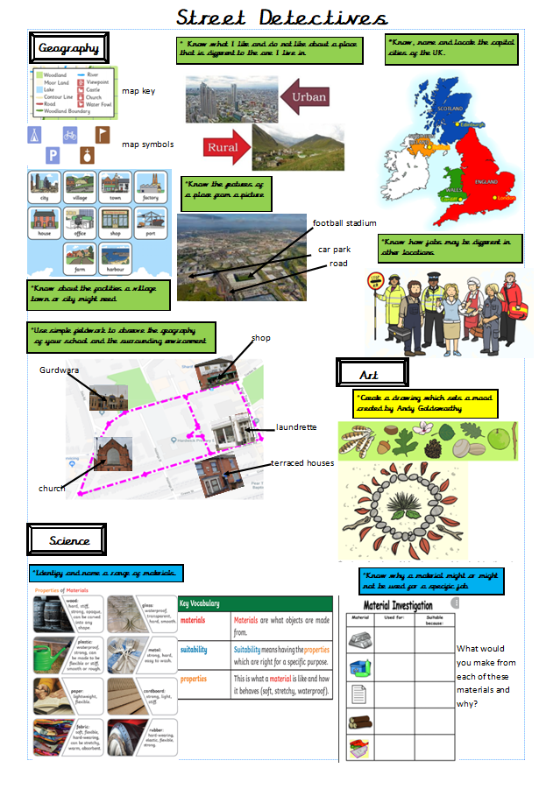
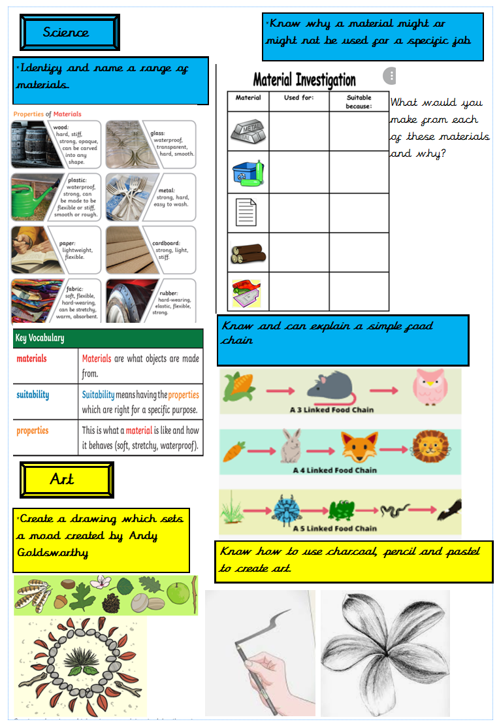
Knowledge organisers

Slide 23
At Hardwick Primary school we do not allow bullying and have anti bullying policies in place. Throughout the year children are taught about the high expectations of behaviour we expect at our school. They are also taught what to do if someone is doing something they do not like.

