Slide 1



Slide 2
Mrs Rowland, Miss Rhodes
1CB-
Mrs Priestland
1CM- Miss Benham
Year 1

Slide 3

Topics this year
Where do I live?
What memories do you have?
Who has paws, claws and whiskers?
What makes a good hero?
Can you fly to space?
What might you find in the woods?

Slide 4
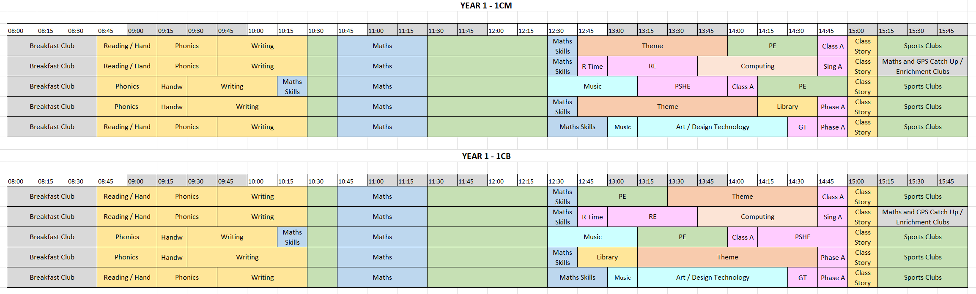
Timetable

Slide 5
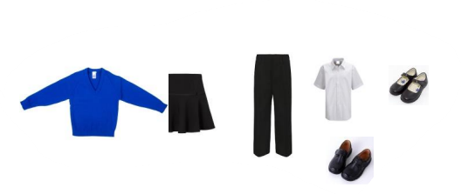
Uniform
Royal blue sweatshirt or cardigan,
Black or grey skirt, pinafore dress or trousers,
White shirt or polo shirt,
Sensible black shoes
If girls wish to wear a hajib then please ensure they are in plain black or royal blue and without pins.
PLEASE PUT YOUR CHILD’S NAME IN THEIR JUMPER/CARDIGAN

Slide 6

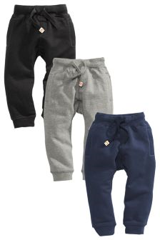

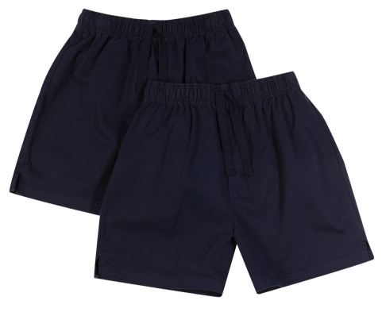
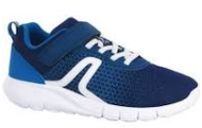
PE
Our PE days are on a Monday and Wednesday
No earrings on PE days. Please can these be taken out at home.
Please can long hair be tied back.

Slide 7
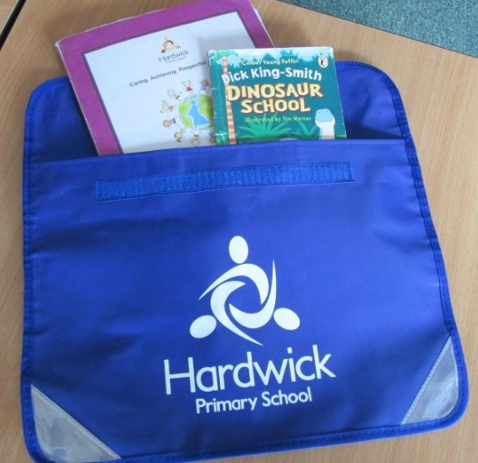
Homework and home challenges
We set a homework challenge sheet once a half term linked the theme and we also set some Maths homework weekly. This goes out on a Friday and must be back by the next Wednesday.

Slide 8
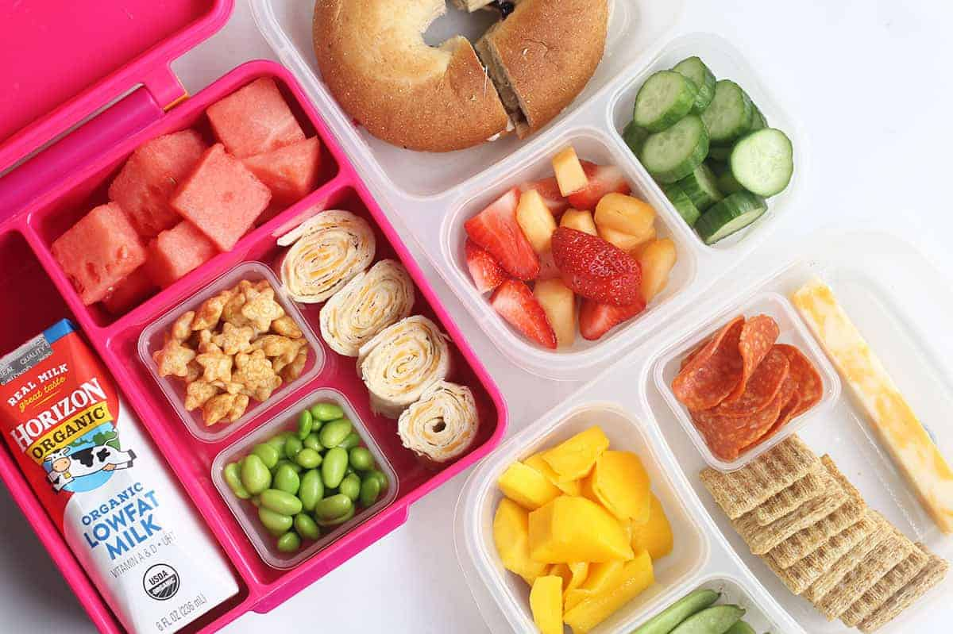
Packed lunch
If your child brings a packed lunch, please make sure they have:
A sandwich or wrap (no chocolate spread)
Fruit, yoghurt, veg sticks
Packet of crisps

Slide 9

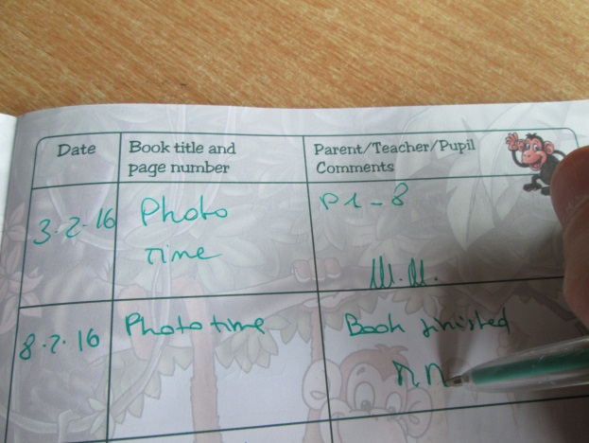
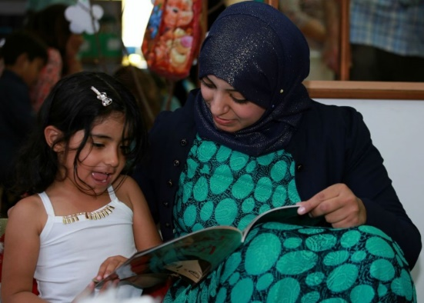

Reading expectations
Please read at home every day.
They will be given a phonics books which they have read at school in the week and a reading for pleasure book which they share with you. They will get a new reading book EVERY FRIDAY.

Slide 10
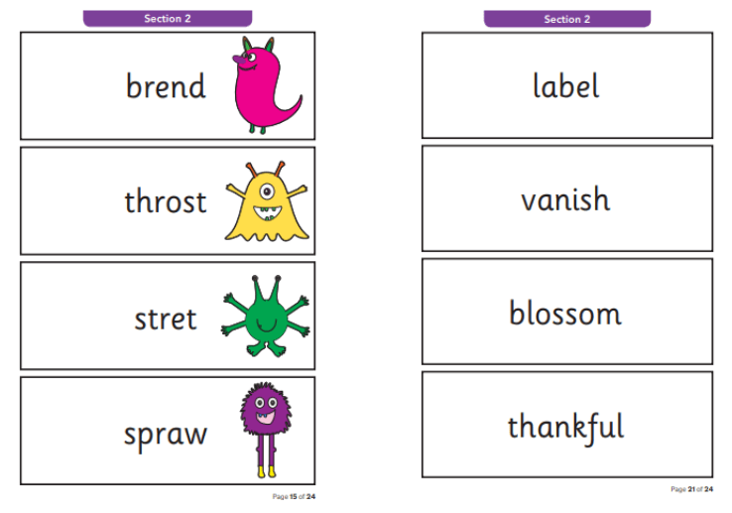
Phonics Screening
In June, the children will complete a phonics screening. They will read 40 words- 20 real words and 20 alien word.
We will be preparing the children for this through phonics lessons.
This will be week beginning 8th June

Slide 11
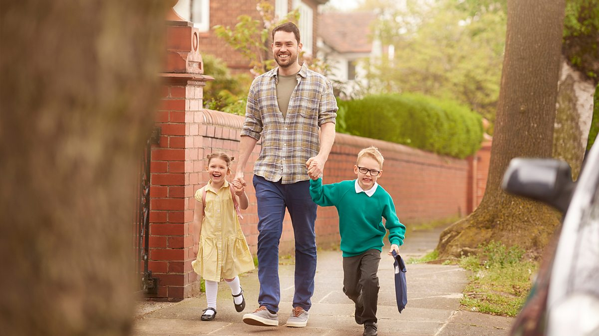
End of the day
Come to the doors for Year 1.
Tell an adult your child’s name and then they will call your child.
Please ensure your child is with you before you walk away.
If someone is picking your child up, please call school and they will let us know.
It must be someone OVER 18 who picks your child up.

Slide 12
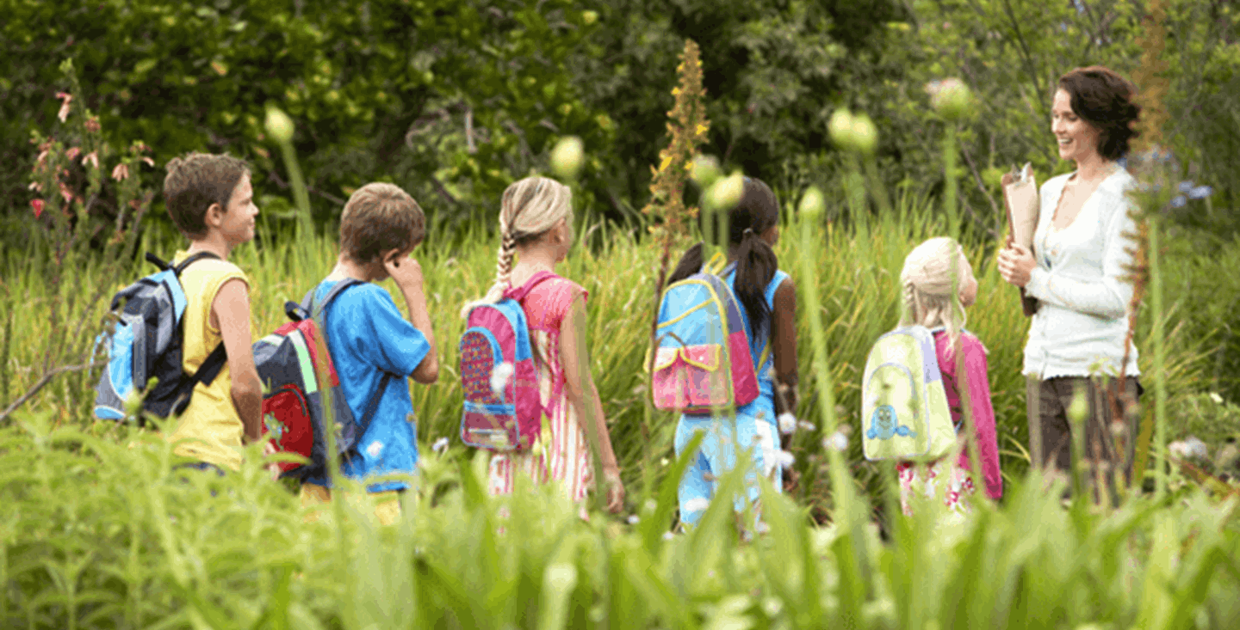
Trips
We have some fantastic trips planned in Year 1
BUT
They cannot happen without your help. IF you can come with us on a trip, please talk to your child’s teacher.

Slide 13
If your child has a problem…..
They should go to an adult they trust. It can be a teacher or adult in Year 1.
Mrs Yates and Mrs Oliver work with us so the children can go them as well.

Slide 14
If you have a problem…..
Talk to your class teacher (Mrs Priestland or Miss Benham)
You can also talk to Mrs Freeman or Mrs Sandhu BUT you should first talk to your child’s teacher

Slide 15

The school is going to be using Arbor to communicate with you from 22nd September.
You can receive urgent updates and send messages, track attendance, view behaviour, view academic progress and reports and manage personal and medical information for you and your child.

Slide 16

Parent Pay
All forms and payment for trips will be using ParentPay.
Please can you check you have a ParentPay account set up and please pay for trips ASAP.

Slide 17

Change in details….
Any change in details such as phone numbers, home address or email address, please let school know.

Slide 18

Raise Children Attendance,
-Raise their Chances!
What does “Good attendance” mean?

Slide 19

Attendance Expectations
All children in school – everyday.
On time
No term time holiday

Slide 20

Research suggest:
The greater the attendance the greater the achievement.

Slide 21
School timings
Breakfast Club (free of charge) starts at 8am
School Gates open at 8:35am
School Gates close at 8:45am (please ensure your child is in school by this time) after this point, your child is late.
The register for the afternoon session will be taken at:
12.30pm closing at 12.35pm for Year 1
Home time - 3:15pm
Gates close – 3:25

Slide 22
Persistent Absentee
90% attendance = ½ day missed every week!!
Mon | Tue | Wed |  | Thur | Fri
 |  | ?
Absent half a day every week

Slide 23
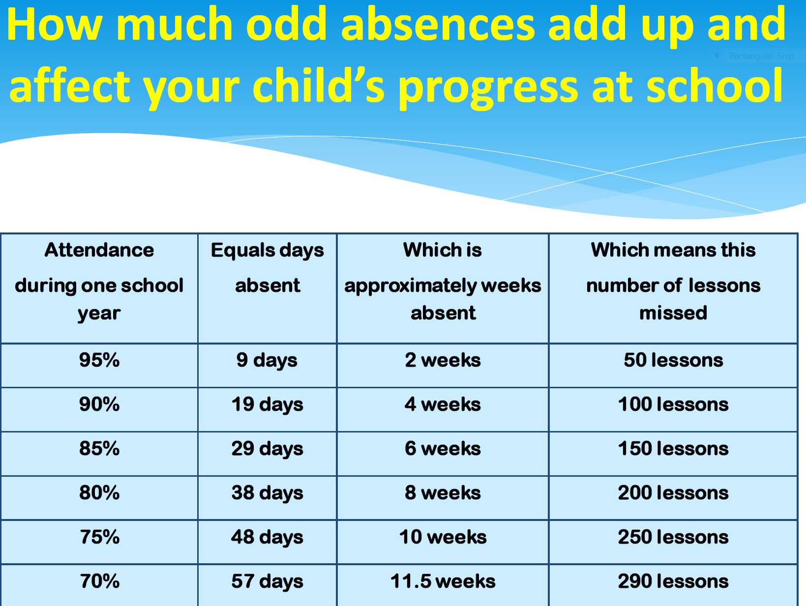

Slide 24
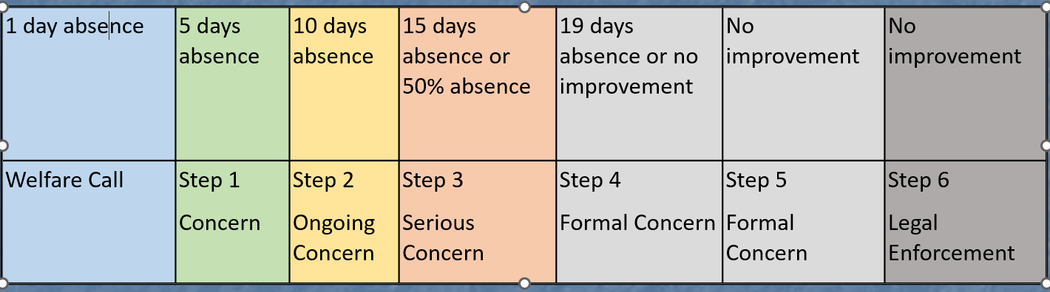
School / Parent / Carer partnership
Please talk to us if you have any concerns.
The school will contact parents if we have any concerns regarding your child’s attendance.

Slide 25

Thank you for coming

