Slide 1
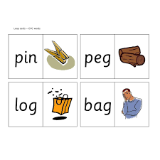
Read the word & click on the picture

Slide 2



cat

Slide 3
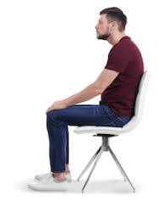
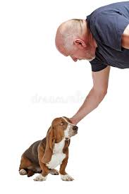
sat

Slide 4
pat

Slide 5
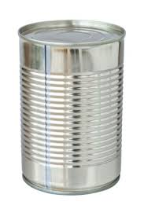

tin

Slide 6

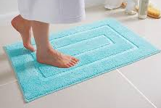
mat

Slide 7
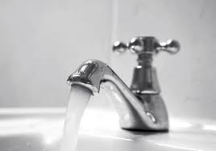
tap

Slide 8
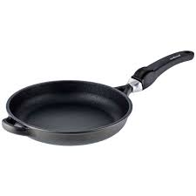
pan

Slide 9

pin

Slide 10
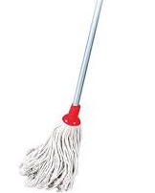
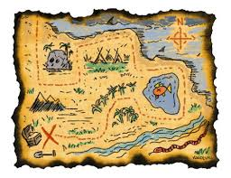
map

Slide 11
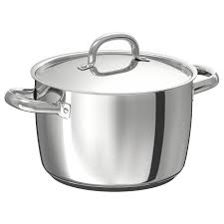
cot

Slide 12

mad

Slide 13
pot

Slide 14
pit

Slide 15
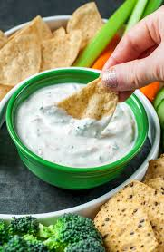

dig

Slide 16
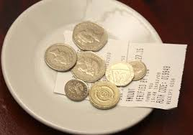
tip

Slide 17

cap

Slide 18
cot

Slide 19
dip

Slide 20
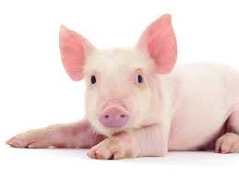
pig

Slide 21

cop

Slide 22
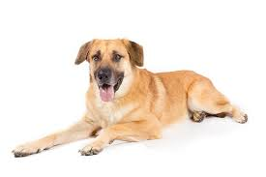

dog

Slide 23
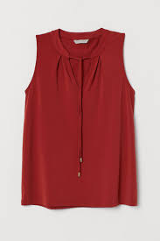
top

Slide 24
dot

Slide 25

pop

Slide 26
fat

