Slide 1
Parents Curriculum Workshop
^{27th} September 2023
Nursery
Mrs. Bletcher

Slide 2
Term | Nursery
Autumn 1 (Science and DT) Who am I? What happens in Autumn? | Who am I? What happens in autumn?
 | Stay and Play with Parents
 | Carving Pumpkins
 | Lulu's First Day Hair Love / Leaf Man Five Little Pumpkins
Autumn 2 (History) What happens at night? What is a winter wonderland? | What happens at night? What is a winter wonderland?
 | Night time Dream Snow / Snowball Dear Santa
Spring 1 (Science and Art) How many colours are in a rainbow? | How many colours are in a rainbow?
 | Red Rockets and Rainbow Jelly The Colour Monster Brown Bear, Brown Bear what do you see?
Spring 2 (History) How do plants and animals grow? | How do plants and animals grow?
 | Oh Dear! Noisy Farm, Who is in the egg?
Summer 1 (Science) Why is moving healthy? | Why is moving healthy?
 | The Very Hungry Caterpillar Colin and Lee Mini Rabbit Not Lost
Summer 2 (Geog) Can you tumble? | Can you tumble?
 | Ready Steady Mo! Every Bunny is a Yoga Bunny The Frog Olympics
Yearly Overview

Slide 3
Nursery Timetable
09:00 | 09:15 | 09:30 | 09:45 | 10:00 | 10:15 | 10:30 | 10:45 | 11:00 | 11:15 | 11:30 | 11:45 | 12:00 | 12:15 | 12:30 | 12:45 | 13:00 | 13:15 | 13:30 | 13:45 | 14:00 | 14:15 | 14:30 | 14:45 | 15:00
CIL | Lit / Phonics |  | CIL |  |  | Maths | CIL |  |  | Class Story |  |  | CIL |  |  | Lit / Phonics |  | CIL |  | Maths | CIL |  |  | Class Story
CIL | Lit / Phonics |  | CIL |  |  | Maths | CIL |  |  | Class Story |  |  | CIL |  |  | Lit / Phonics |  | CIL |  | Maths | CIL |  |  | Class Story
CIL | Lit / Phonics |  | CIL |  |  | Maths | CIL |  |  | Class Story |  |  | CIL |  |  | Lit / Phonics |  | CIL |  | Maths | CIL |  |  | Class Story
CIL | Lit / Phonics |  | CIL |  |  | Maths | CIL |  |  | Class Story |  |  | CIL |  |  | Lit / Phonics |  | CIL |  | Maths | CIL |  |  | Class Story
CIL | Lit / Phonics |  | PE |  | CIL |  |  |  |  | Class Story |  |  | CIL |  |  | Lit / Phonics |  | PE |  | CIL |  |  |  | Class Story

Slide 4
Nursery Timetable
Literacy sessions are focussed on a quality text and Nursery rhyme for a two-week cycle. The learning intention of Nursery Literacy is a focus on recall. The aim is for children to independently recall the Nursery rhymes and stories that we have learnt in Nursery. We use story maps as a teaching prompts to encourage children to remember using words and actions.
Phonics sessions are planned using the Phonics scheme Little Wandle. We also use a document called Launch Pad for Literacy. These are short sessions (10 mins max) that use games to develop children’s listening skills, awareness of rhyme, awareness of initial sounds. There is also a focus on developing children’s ability to blend words independently, distinguish between different sounds, and develop phonemic awareness.
Maths sessions are planned using Hardwick’s Maths objectives (which are lifted from the non-statutory Government curriculum guidance on how children 0-5 learn). We use a yearly Maths overview to ensure all objectives are covered over the course of an academic year. Sessions are short with a focus this term on reciting numbers 0-10, representing numbers 0-5 on fingers, counting objects 0-5, and matching numerals and amount.
All children’s learning in Nursery is underpinned by the environment (both indoors and outdoors). Play is so significant in a Nursery child’s development. The Nursery environment (like directed learning) is changed weekly based on our current theme, gaps in assessment and children’s own interests.

Slide 5
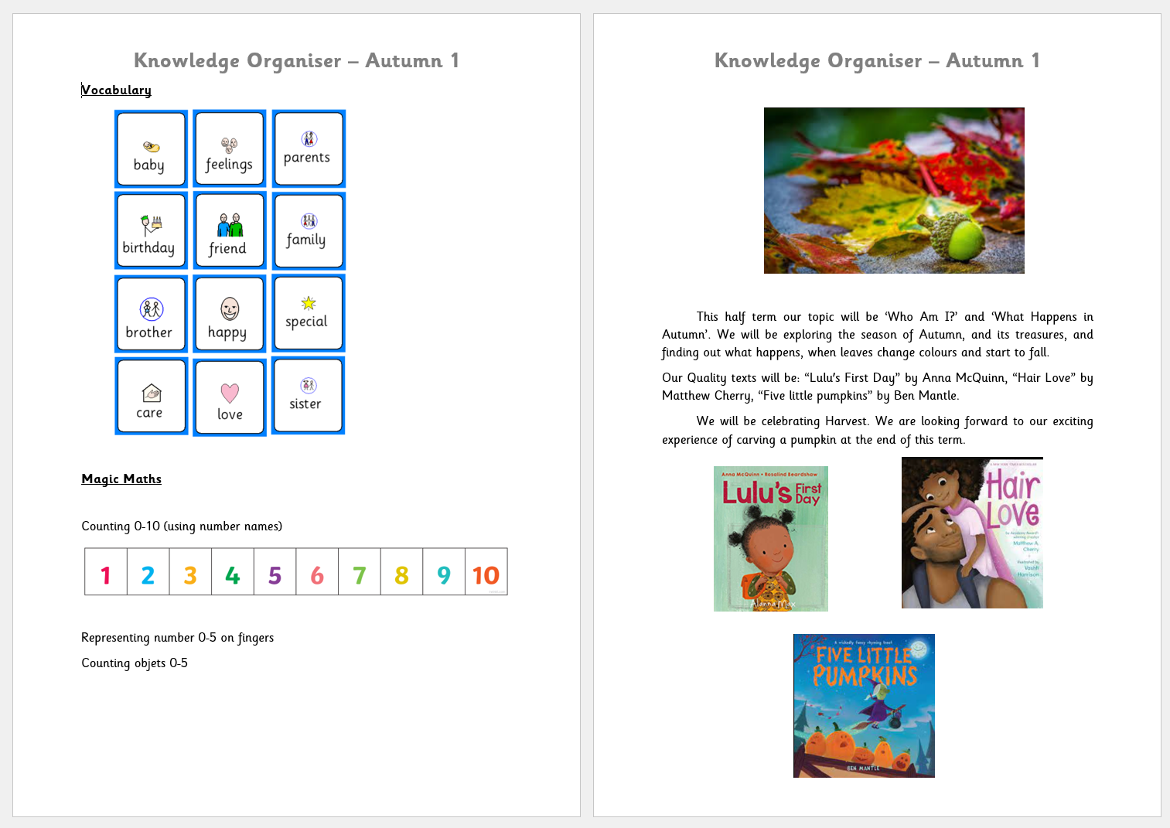
Knowledge Organisers

Slide 6
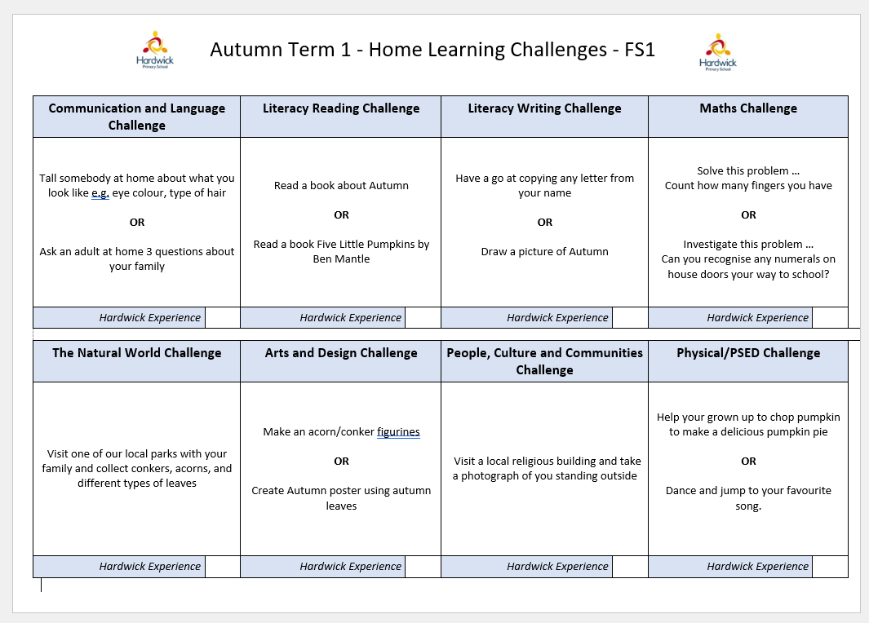
Home Challenges

Slide 7
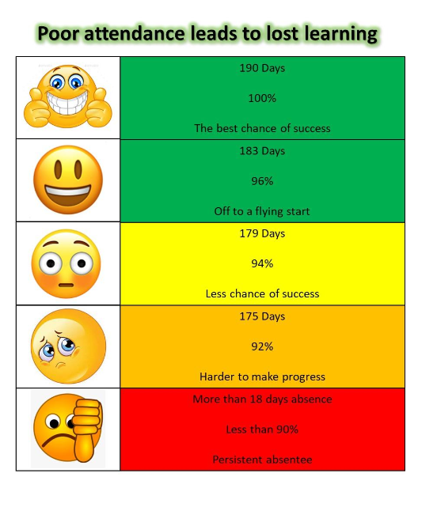
Punctuality
and
Attendance
If your child is ill and won’t be attending Nursery, then you need to ring the office on 01332 272249. If you do not ring in your child’s absence will be unauthorised.

Slide 8
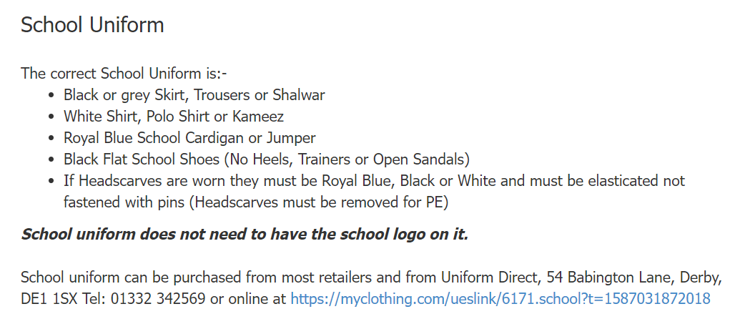
School
Uniform

Slide 9
PE
PE days
Tuesday - morning session group
Friday - afternoon session group

Slide 10
If we have an upcoming trip then you will receive a letter confirming the date, location and times of the trip. If you would like your child to go on the trip you will have to consent via Parent Pay. If there is a charge for the trip you will need to pay via Parent Pay. If you would like to volunteer as a parent helper for the trip you will need to complete a risk assessment with the class teacher (that will need to be cleared) in advance of the trip.
We do have an upcoming trip on the 8th of December to see ‘Three Billy Goats Gruff’ at Derby Theatre.
Trip information

Slide 11
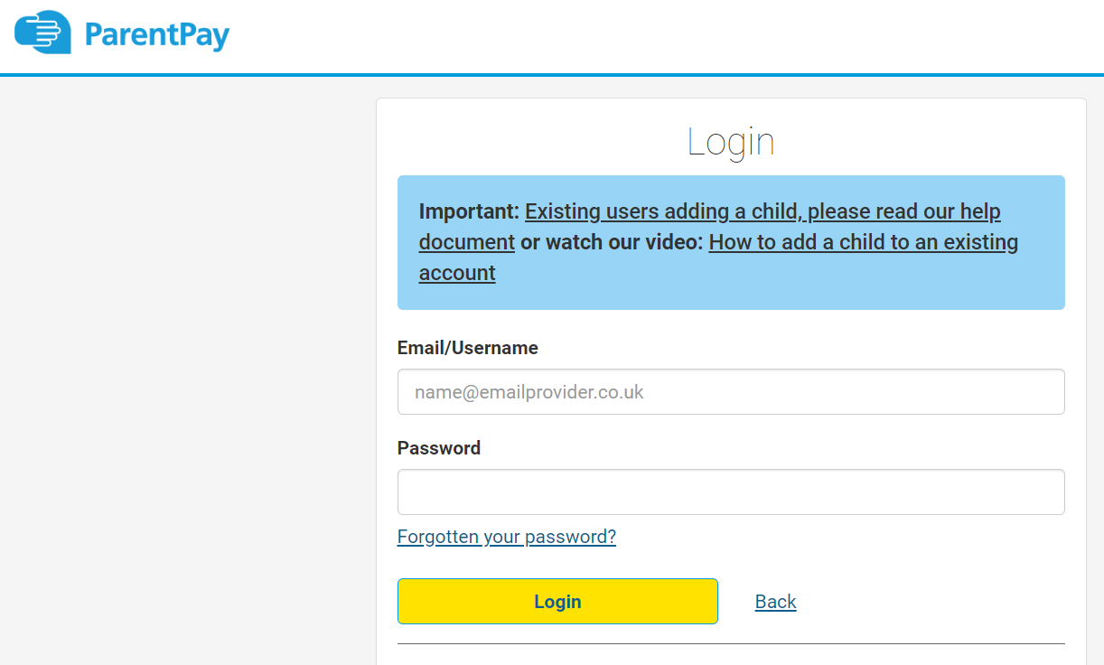
Communication

Slide 12
At the end of the Nursery session the children wait on the carpet supported by a Hardwick adult. We want the children to feel as calm as possible and stay seated (until their name is called). A key Nursery adult then opens the door at the bottom of Nursery, and we call each child when their adult comes to the door. We ensure each child is safely with their adult before we let them leave Nursery. We do not release if an adult comes to collect who has not been confirmed by the office.
End of day Nursery handovers

Slide 13
If you have any concerns, please don’t hesitate to contact Mrs Freeman or myself.
Thank you for your time!
Any concerns

