Slide 1

Welcome to
Year 3

Slide 2



Attendance and punctuality
Gates open at 8:40.
Children must be in school before 8:55.
Messages about non-attendance– go to/phone the office
If you arrive after 8.55 am, you are late!
Please sign in at the office.
Pick up your child from school at 3:15pm.
Please be punctual!

Slide 3
Safety of children
Make sure to drop children of inside the school. Do not leave children on the road or ask them to get out of the car. Once an adult has received them then you may leave.
At the end of the day, we must dismiss and hand over children to their parents or a designated adult, who staff are aware off. Do not walk away without your child with you.
If someone else is picking your child up, then please ring the office and give the details of the person. They will pass this information to the teacher.
If there any concerns about your child, please raise them with your child’s class teacher first.

Slide 4
Timetabling
All lessons are timetabled and have a designated time to be taught.

Slide 5
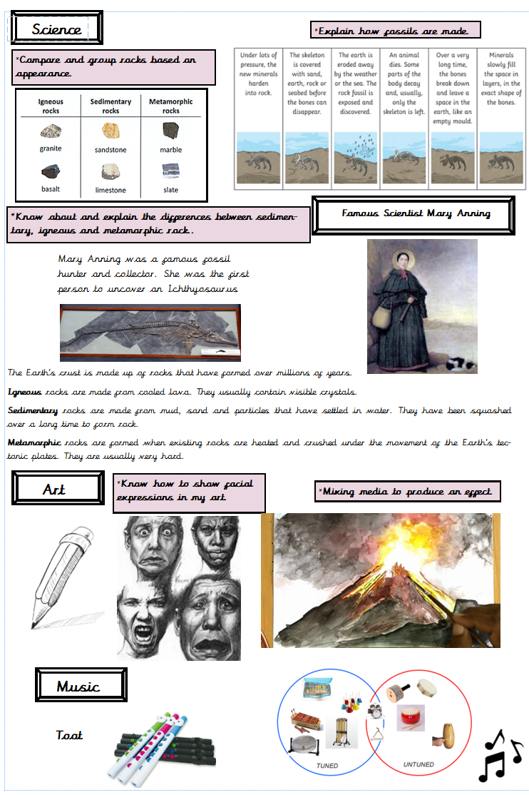

Curriculum Overviews & Knowledge Organisers
Knowledge organisers are sent home at the beginning of each term. You must read and discuss these with your children regularly.
Ask your children what they have learnt and quiz them on the knowledge and vocabulary.
You can access the curriculum overview and see what your child is learning each half term on the school website.

Slide 6
Themes
Autumn 1-Why does the Earth shake?
Autumn 2-What was life like in Ancient Britain?
Spring 1-What brings people to cities?
Spring 2- Who were the Ancient Egyptians?
Summer 1-Why is metal mighty?
Summer 2-How does a river start and where does it go?

Slide 7
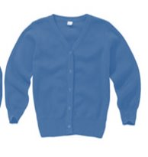
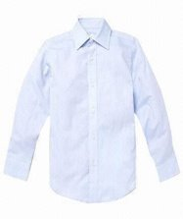
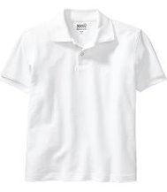
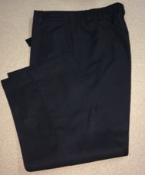
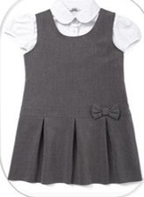
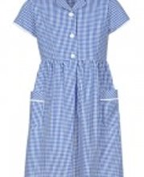
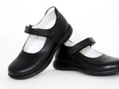
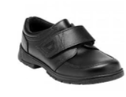
Uniform

Slide 8

Uniform
Black jeans are not part of the uniform. ​
Dangling earrings are not allowed. Trainers and open-toed sandals are not allowed. Children cannot join in physical activity wearing jewellery and staff cannot help them remove it, so please keep jewellery at home on P.E. (Tuesday and Thursday every week)

Slide 9
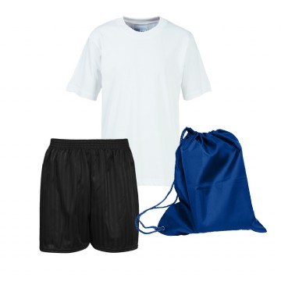
P.E
Tuesday and Thursdays
P.E kit:
  Plain black or navy shorts/jogging bottoms
  White t-shirt – optional school logo
  Pumps/trainers
  No jewellery worn for P.E

Slide 10


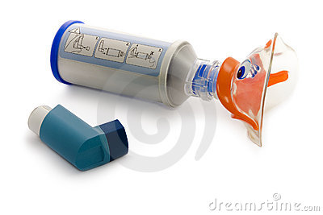


Please inform the office about any medical condition related to your child.
Give us any medicine or an inhaler,epipen if prescribed
We do first aid but we don’t give any medicine without your permission.

Slide 11
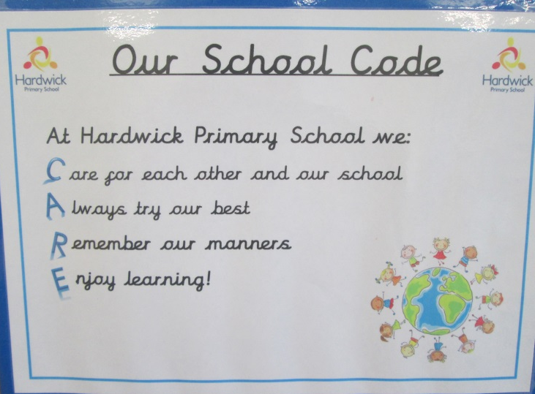
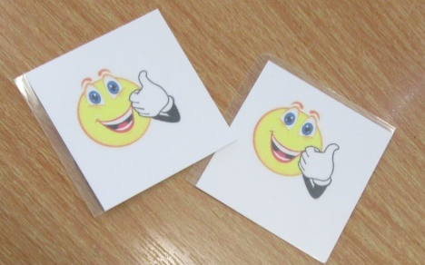
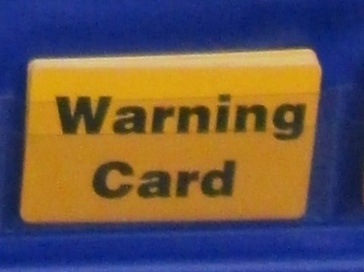


We encourage our children to CARE.
Children receive “smileys” for good work. On Fridays, we have a “Superstar Assembly”. Children receive certificates for achievements.
Children also receive “yellow or red cards” for poor behaviour. You may receive a letter or be asked to have a meeting.

Slide 12

Reading at home
Read at home is VERY important. An adult must complete the reading record at least three times a week
Write the number of pages read by your child and sign the Reading Record Book.

Slide 13
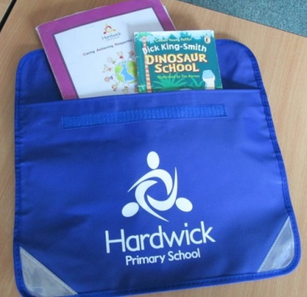
Homework
In Year 3, children will be asked to do the
following at home:
*READING
Read at least 3 times per week
*SPELLINGS
Learn spellings. These are given on a Monday and tested on Friday. If your child is still on the Little Wandle (phonics programme) they will not receive weekly spellings, you must go through the different sounds and spellings.
*HOMEWORK
One piece of homework and ‘2do’s’ set on Purple Mash. This is given on a Friday and needs to be returned by Tuesday.
Theme based tasks (grid) – 1 task to be completed each week.
Please also help your child to learn their times tables
(2, 3, 4, 5, 8 and 10).

Slide 14
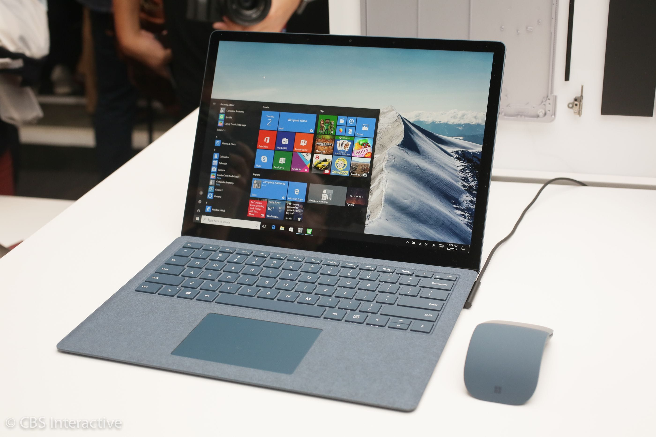
Computing
Children will take their devices home on Friday and they must be in school for Monday.
Children to complete Purple Mash ‘2do’s’, log on TTRockstars and access Collins eBooks.

Slide 15

Online safety
Safeguarding
Cyber bullying
Monitor your child’s computer use

Slide 16
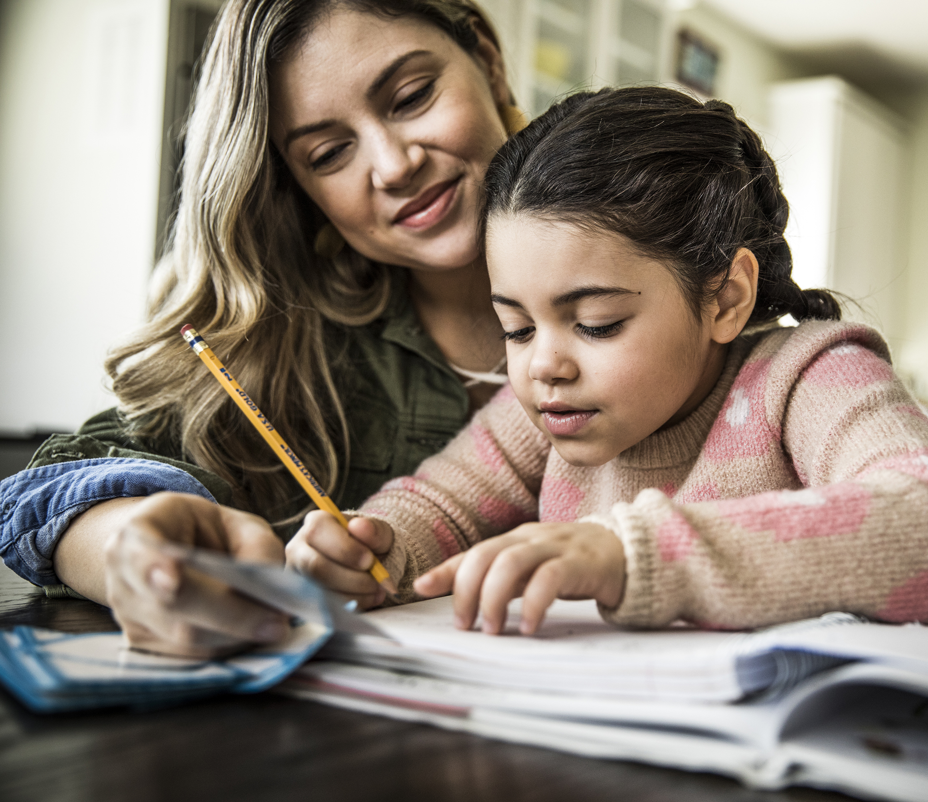
Homework
Given out every Friday, to be handed in by Tuesday
  Reading
  Timetables
  TT rockstars
  Purple Mash
  Theme based tasks (grid)
Parental support

Slide 17
Weduc and Parent Pay
Regularly access Weduc to see updated messages from the Year 3 team and general school updates.
Trip letters are uploaded on Weduc
Consent and payment to be completed online on Parent Pay
If you need any help, please go to the office. They are always happy to help ☺

Slide 18
Any questions?

