Slide 1



Slide 2
Mrs Rowland, Miss Rhodes & Ms Eadson
1CB-
Mrs Priestland
1CM- Miss Benham
Year 1

Slide 3
Topics this year
What happened to the Dinosaurs?
What memories do you have?
Who has paws, claws and whiskers?
What makes a good hero?
Can you fly to space?
What might you find in the woods?

Slide 4
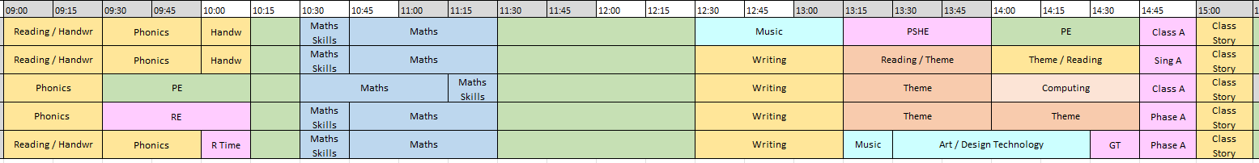
Timetable

Slide 5
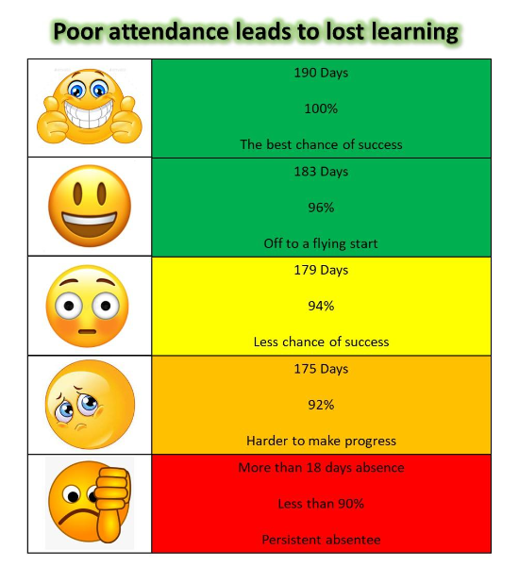
Attendance
Your child needs to be in school EVERYDAY.
If they are poorly, bring them to school and we can decide if they should be in school.
At the end of the year, if you child has over 98% attendance, they go into a prize draw.

Slide 6
If your child is not at school….
Please can you call the school office before 9am on the day your child is not at school.
Please can you try and make appointments after school.
PLEASE AVOID GOING ABROAD IF YOU CAN.

Slide 7
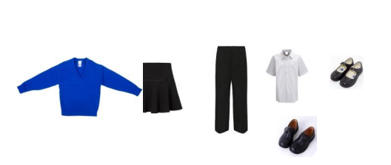
Uniform
royal blue sweatshirt or cardigan,
black or grey skirt, pinafore dress or trousers,
white shirt or polo shirt,
Sensible black shoes
If girls wish to wear a hajib then please ensure they are in plain black or royal blue and without pins.

Slide 8

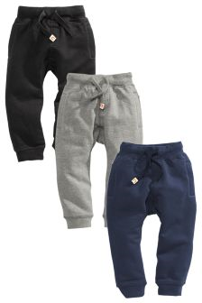

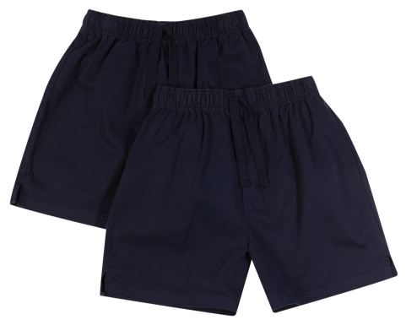

PE
Our PE days are on a Monday and Wednesday
No earrings on PE days. Please can these be taken out at home.

Slide 9
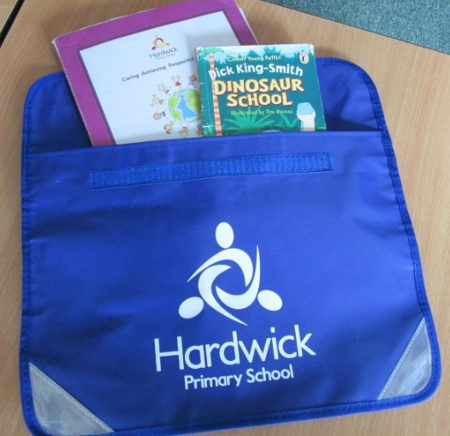
Homework and home challenges
We set a homework challenge sheet once a half term linked the theme and we also set some phonics/Maths homework weekly. This goes out on a Friday and must be back by the next Tuesday.

Slide 10

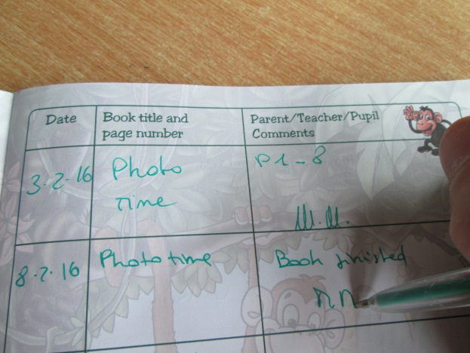
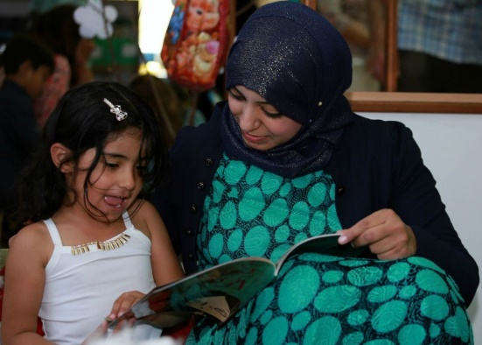

Reading expectations
Please read at home 3 times a week.
They will be given a phonics books which they have read at school in the week and a reading for pleasure book which they share with you. They will get a new reading book EVERY FRIDAY.

Slide 11
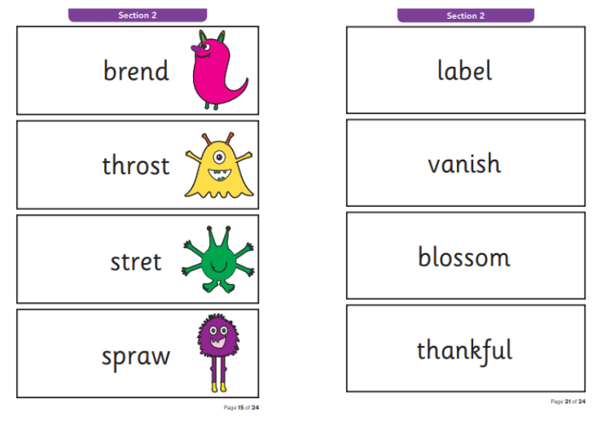
Phonics Screening
In June, the children will complete a phonics screening. They will read 40 words- 20 real words and 20 alien word.
We will be preparing the children for this through phonics lessons.

Slide 12
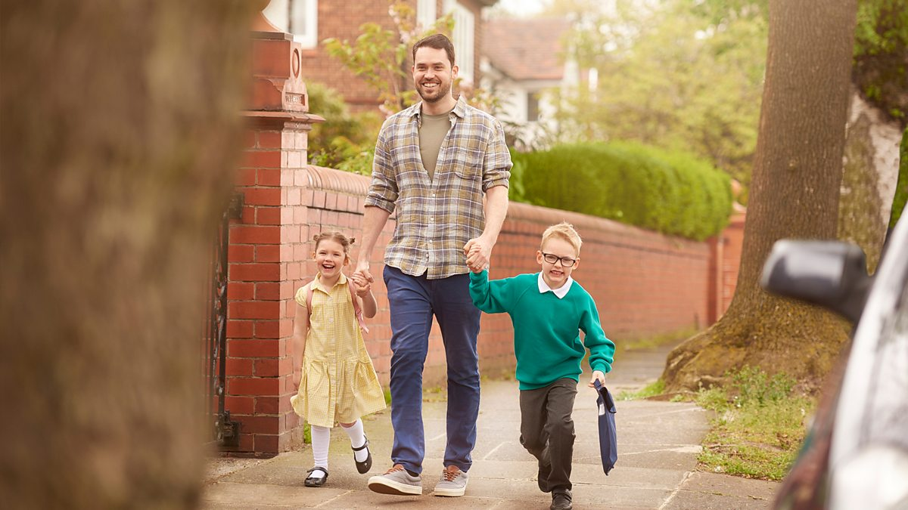
End of the day
Come to the doors for Year 1.
Tell an adult your child’s name and then they will call your child.
Please ensure your child is with you before you walk away.
If someone is picking your child up, please call school and they will let us know

Slide 13

Trips
We have some fantastic trips planned in Year 1
BUT
They cannot happen without your help. IF you can come with us on a trip, please talk to your child’s teacher.

Slide 14
If your child has a problem…..
They should go to an adult they trust. It can be a teacher or adult in Year 1.
Mrs Yates and Mrs Oliver work with us so the children can go them as well.

Slide 15
If you have a problem…..
Talk to your class teacher (Mrs Priestland or Miss Benham)
You can also talk to Mrs Freeman or Mrs Sandhu BUT you should first talk to your child’s teacher

Slide 16

WEDUC
We use this to communicate with you.
We will send messages to you on this. If you don’t have WEDUC, please go to the office.
ALL FORMS WILL BE ON THIS.

Slide 17

Parent Pay
All forms and payment for trips will be using ParentPay.
Please can you check you have a ParentPay account set up and please pay for trips ASAP.

Slide 18

Change in details….
Any change in details such as phone numbers, home address or email address, please let school know.

Slide 19

Thank you for coming

