Slide 1

Year 1 parents information
English and Maths
November 2025

Slide 2

English in year 1
What do we do in reading?
We follow ‘Little Wandle’ to teach phonics. Phonics teaches the sounds that make up words. The children are taught to recognise the letters and say the sounds. They then blend these sounds to read the word. We have daily 30 minutes phonics lessons.
For example: c a t = cat b oa t = boat
w i tch =witch p or t r ai t = portrait
We also learn to read ‘tricky words’ on sight. These are words that are not decodable.
For example people sure said

Slide 3
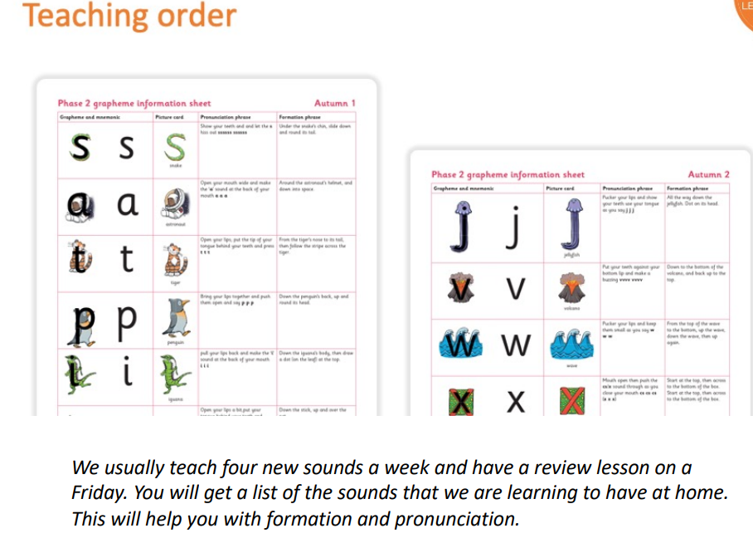
What do we do in reading?

Slide 4
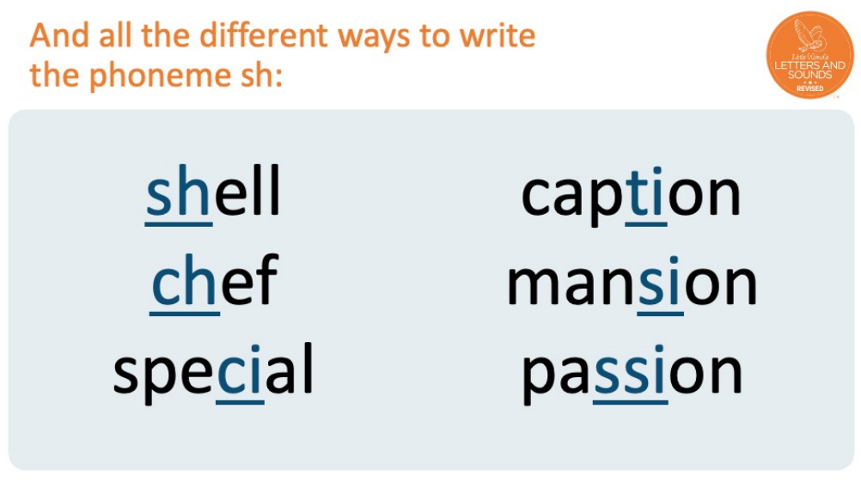
What do we do in reading?

Slide 5

English in year 1
What do we do in reading?
In addition to teaching the reading of words and sentences in phonics lessons, we hear children read 3 times a week.
This book will be closely matched to their knowledge of letters and the sounds they make. They will practice it 3 times with us at school, then bring this book home to read the following week.

Slide 6
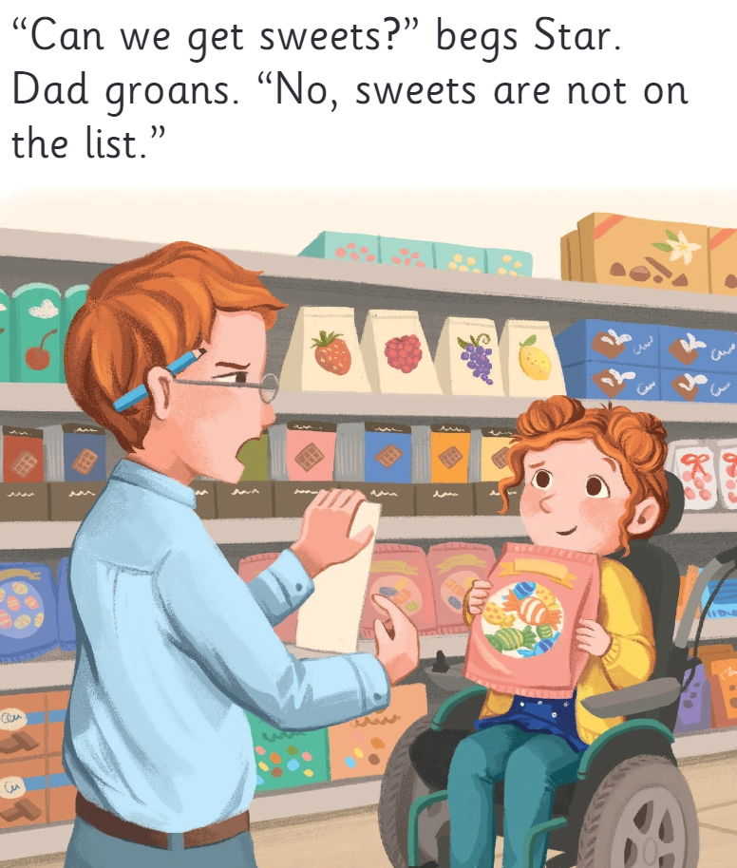
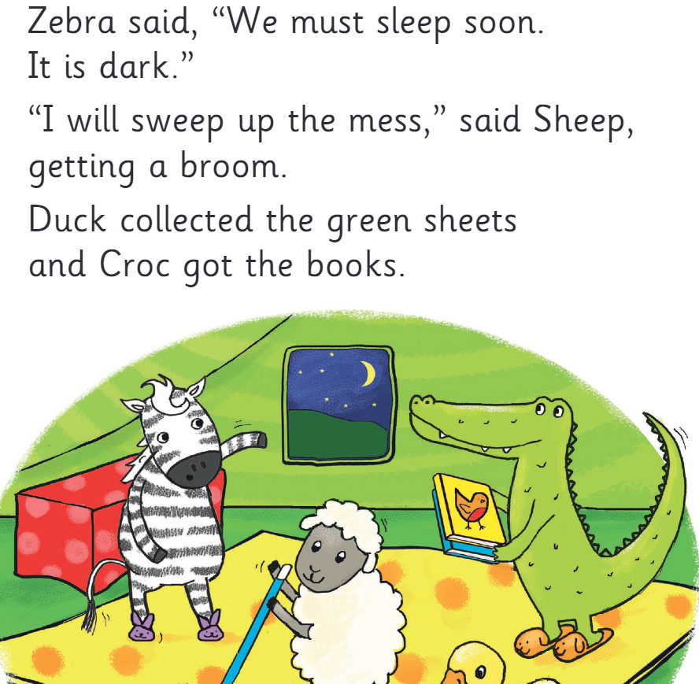
What do we do in reading?
At this point in year 1, the children should be able to read books like this:

Slide 7
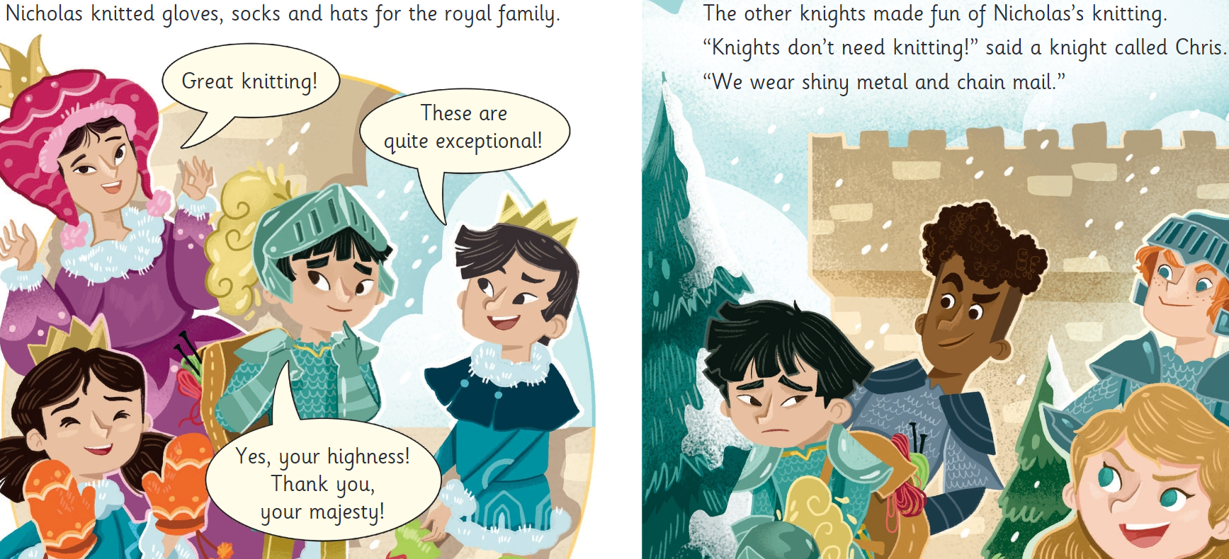
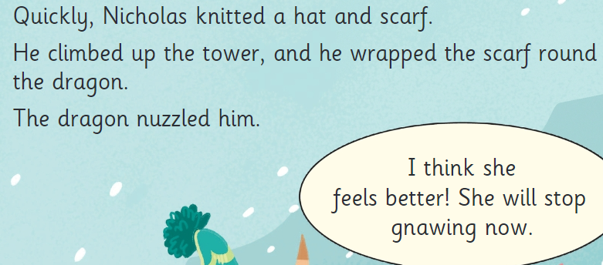
What do we do in reading?
By the end of year 1, the children should be able to read books like this:

Slide 8
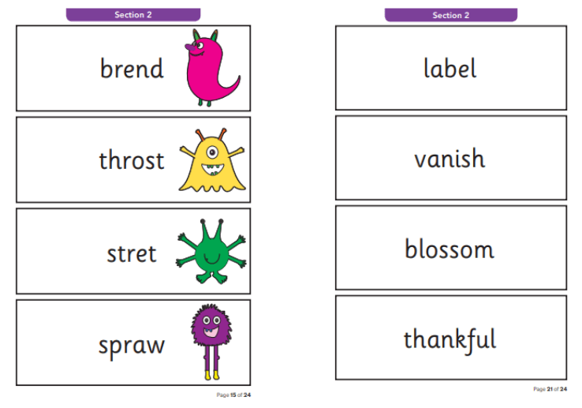
Phonics Screening
In June, the children will complete a phonics screening. They will read 40 words- 20 real words and 20 alien word.
We will be preparing the children for this through phonics lessons.

Slide 9
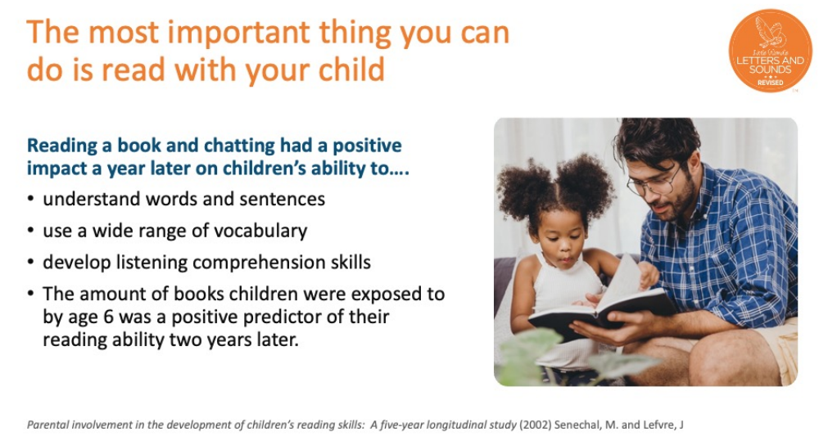
What can you do to help?

Slide 10
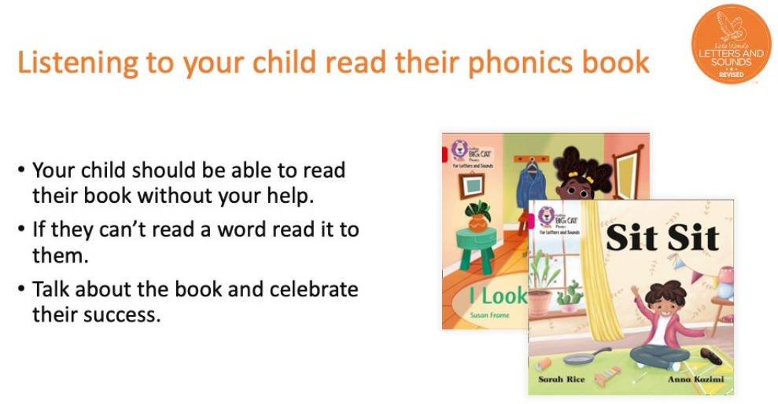
What can you do to help?

Slide 11
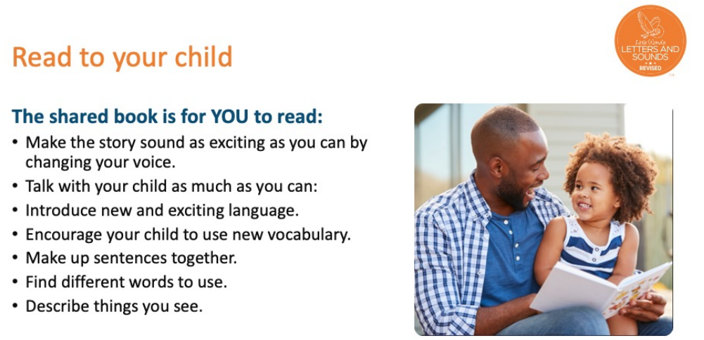
What can you do to help?

Slide 12
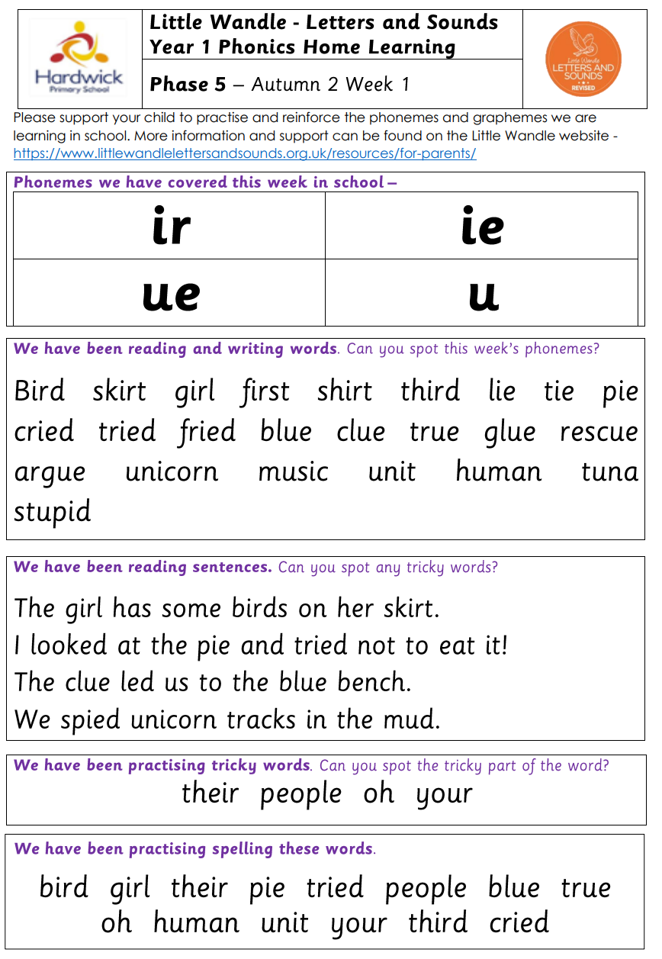
What can you do to help?
Practice reading the words and sentences we send home each week.
Remember, it is OK to sound out to begin with, but practise until you know how to read the words without sounding out.
Remember: do not try to sound out the ‘tricky words.’

Slide 13
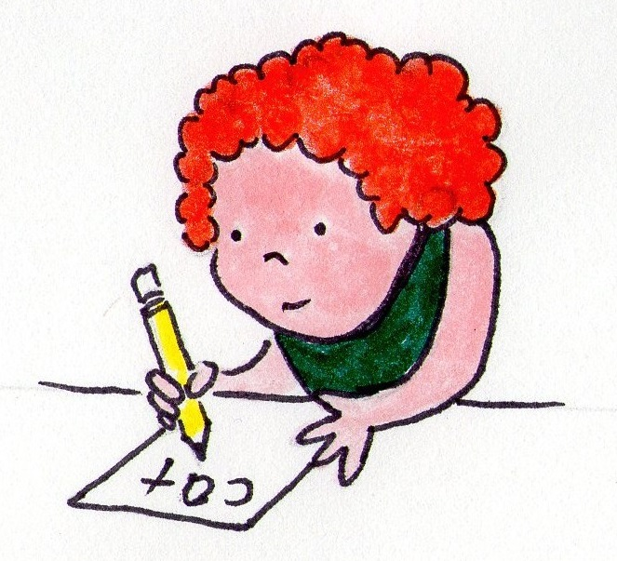
English in year 1
What we do in writing
Orally compose a sentence
Use finger spaces
Use capital letters for starts of sentences, names and the word ‘I’
Use full stops
Join two ideas using ‘and’
Write sentences that can be read by themselves and others
Sequence events to form narratives.
Use question marks when required.
Spell using 40+ phonemes and make phonetically plausible attempts at words.
Spell ‘tricky words’
Spell days of the week
Spell simple compound words (e.g. rainbow, laptop)
Form letters correctly.
For number correctly.

Slide 14
English in year 1
What we do in writing
Spelling:
We practice spelling every day in our daily phonics sessions.
Pupils are taught to say the word, segment the word and write each grapheme as they hear the phonemes in the word.
If the word uses letter patterns the children have not been taught it is fine for them to use the ways they do know to spell, for example, terrible = teribul they have not learnt ‘le’ or ‘rr’
Once they have learnt the letter patterns, they should use them correctly in their writing.

Slide 15
What can you do to help?
Practice spelling words from the homework sheets.
Practice writing sentences using the words and sentences from the homework sheets.
Remember capital letters, full stops and finger spaces.

Slide 16
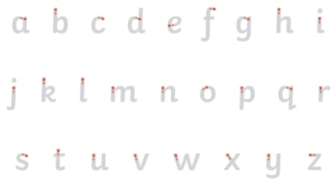
What can you do to help?

Slide 17
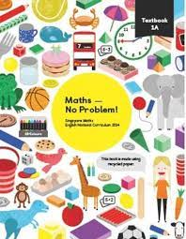

Maths in Year 1
What do we do?
We follow a programme called Maths No Problem!
Throughout the year, the children will work their way through two books which covers all the objectives in the Year 1 National Curriculum.

Slide 18
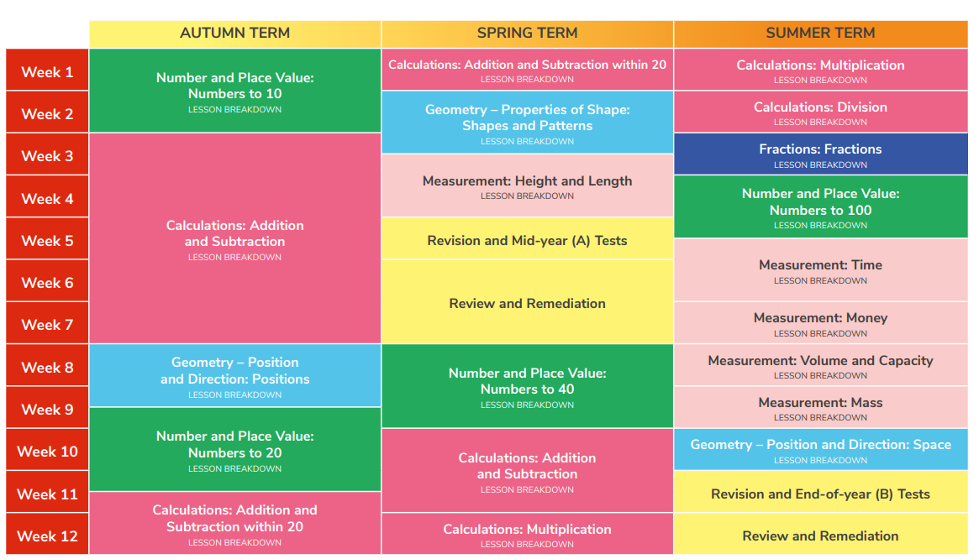
This is what we will be covering in the year.

Slide 19
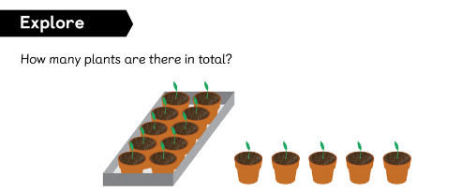
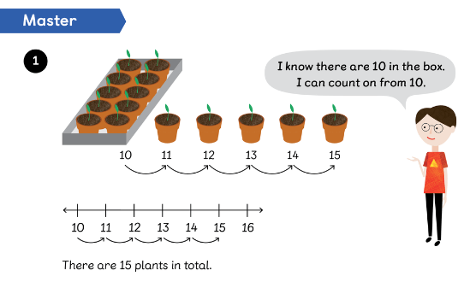
Maths in Year 1
How do we teach it?
We start with an explore. This is usually a picture and we talk about it.
We then talk about different ways we can answer the question and teach different methods.

Slide 20
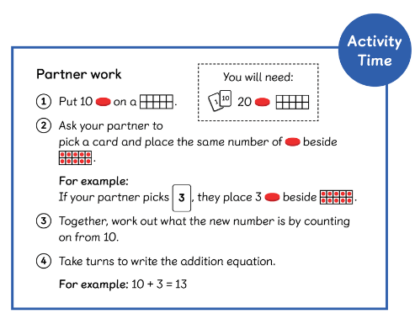
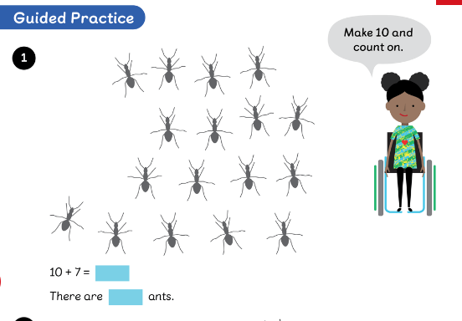
Maths in Year 1
How do we teach it?
Sometimes we will have a game or activity to help learn new methods.
We then practice as a class on whiteboards or in our journal before we move onto the workbook.

Slide 21
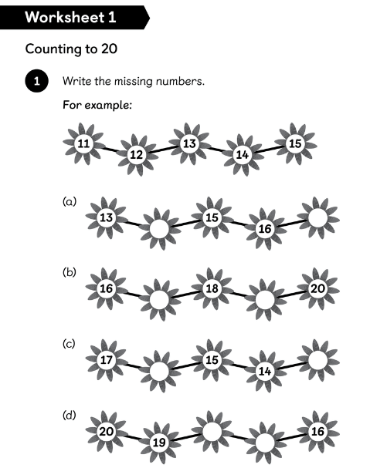
Maths in Year 1
How do we teach it?
Children will then complete the worksheets linked to the lesson.

Slide 22
Maths in Year 1
Fluency
Fluency is where a child is able to quickly use their skills to solve a problem.
Some areas we have worked on so far are:
Counting forwards and backwards to 10.
Number bonds to 5 and 10
1 more and 1 less

Slide 23
By the end of year, we would like them to be able to…
Count to 100, forwards and backwards.
Find 1 more and 1 less from any number
Write numbers 1 to 20 in numbers and words
Know number bonds to 10
Add and subtract numbers up to 20
Know odd and even numbers
Find ½ and ¼ of objects, shapes and numbers

Slide 24
By the end of year, we would like them to be able to…
Tell the time using o’clock and half past
Know the value of coins and notes
Name 2D and 3D shapes
Know how many days are in a week, how many months in a year.
Begin to measure height, length, weight, capacity and time.

Slide 25
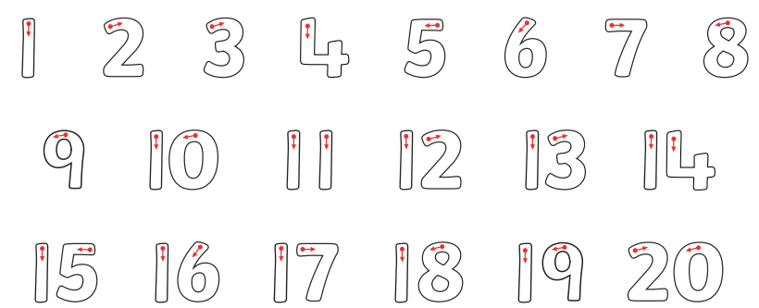
Maths Year 1
How can you help at home?
Number formation

Slide 26
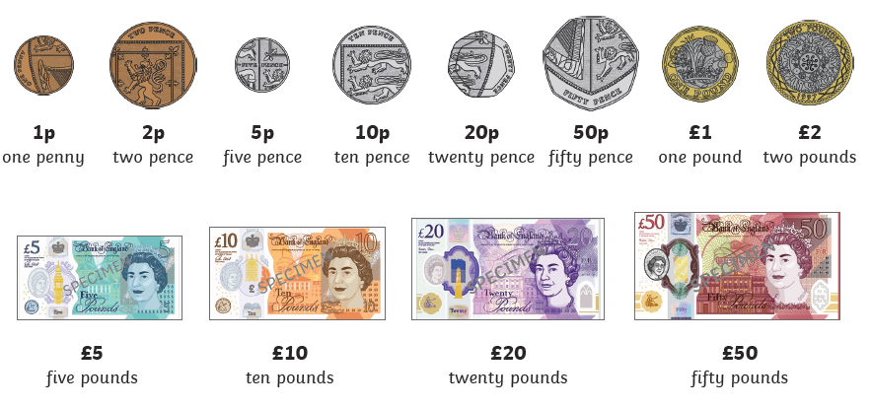
Maths Year 1
How can you help at home?
Coin and note recognition

Slide 27
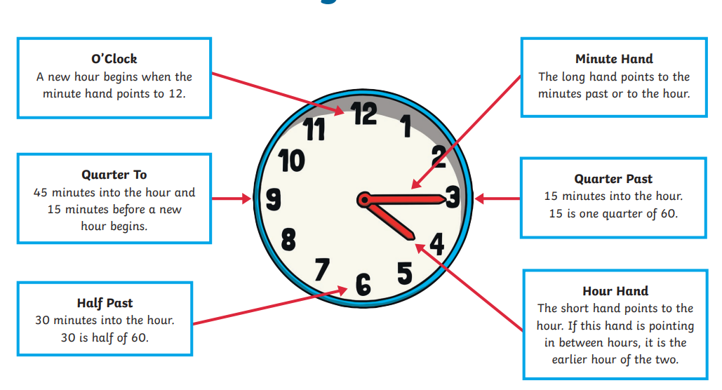
Maths Year 1
How can you help at home?
Telling the time- o’clock and half past

Slide 28
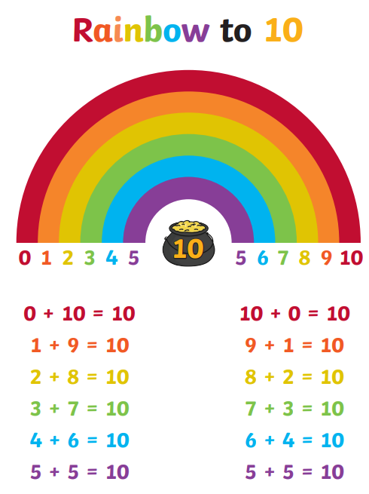
Maths Year 1
How can you help at home?
Know number bonds to 10

