Slide 1

E
Parent Workshop
Year 4
October 2023

Slide 2
E
Attendance
Authorised Absence
An authorised absence is when your child has been given permission to be absent from school. Regular reasons for authorised absence are illness, medical and dental appointments, religious observance, exceptional circumstances and exceptional leave. Authorised absence is at the Head of School’s discretion and you may be required to provide school with evidence of the absence:
Appointment letter or card
Letter or note from GP
Mediation or prescription with correct name and dates
Routine doctor and dental appointments should be booked at the end of the day and during school holidays where possible. We know that sometimes you cannot choose hospital appointments so please make sure that you return your child to school after their appointment has finished. Evidence should be provided for all scheduled appointments.

Slide 3
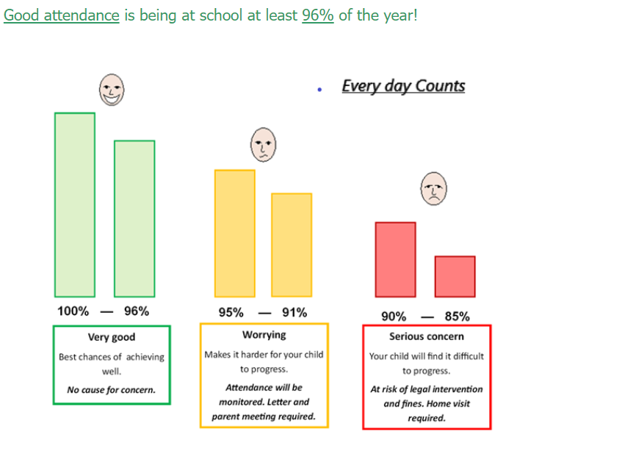
E
Attendance

Slide 4
E
Punctuality
Not only is it important to come to school every day, but it is equally important to make sure your child arrives on time. Our gates open at 8:45am and close at 9am.
If you arrive after 9am, your child will be marked as late.
If your child is 5 minutes late every day for a year this will add up to over 3 days of lost learning. If your child is 15 minutes late every day for a year this will add up to 2 weeks of lost learning! The school monitors and tracks children’s punctuality daily. If your child is persistently late you will be invited to a meeting to discuss this.

Slide 5
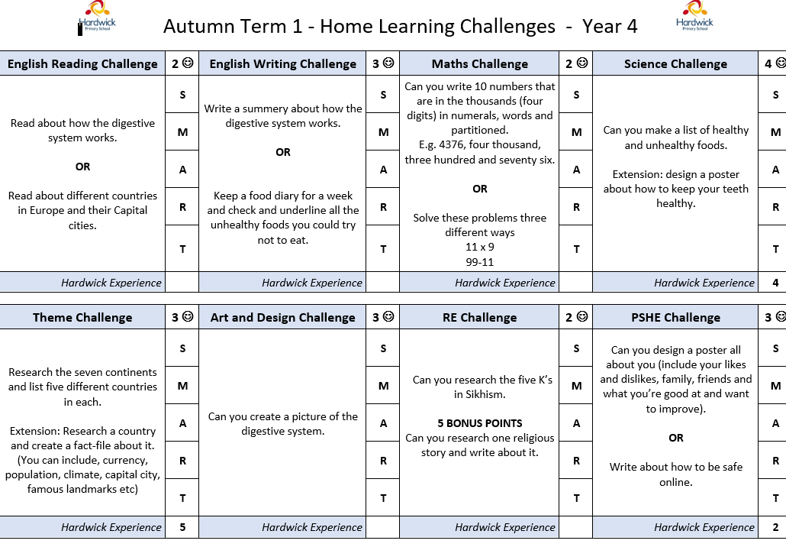
E
Home learning
Reading at least 3 times a week to an adult. Adult to sign reading record book. Reading books checked on a Friday.
Use school device (surface) to access Purple Mash or TTRS to practise times tables.
Practise weekly spellings.
Choose a home learning
Challenge to complete.

Slide 6
E
School Uniform Expectations
The correct School Uniform is:-
Black or grey Skirt, Trousers or Shalwar
White Shirt, Polo Shirt or Kameez
Royal Blue School Cardigan or Jumper
Black Flat School Shoes (No Heels, Trainers or Open Sandals)
If Headscarves are worn they must be Royal Blue or Black and must be elasticated not fastened with pins (Headscarves must be removed for PE)
School uniform does not need to have the school logo on it.

Slide 7
E
PE Kit Expectations
Physical Education
P.E. is compulsory - all pupils must have their PE kit in school at all times.
The Correct PE Kit is:-
Plain Black Shorts or Leggings
Plain White Long or Short Sleeved T-Shirt
Black Plimsolls or Trainers
During Winter Months children can wear a plain Black or Grey Tracksuit
Headscarves and all Jewellery must be removed for PE Lessons (unless Balaclava Style Hijaab)
If children have forgotten their kit they must use spare school kit.

Slide 8
E
Timetabling

Slide 9
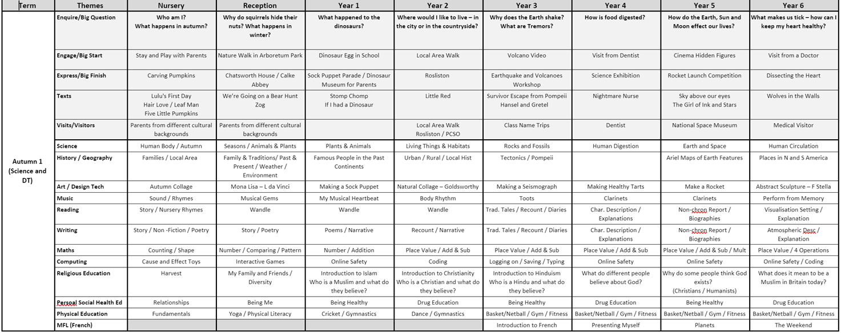
E
Curriculum Overviews

Slide 10
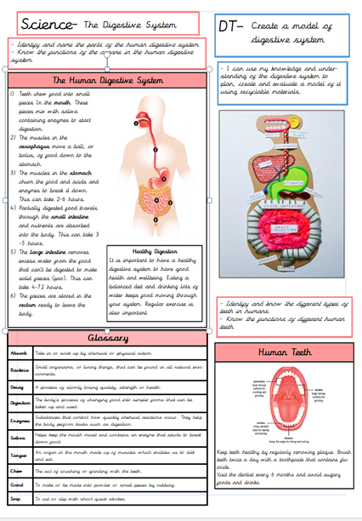
E
Knowledge Organisers

Slide 11
E
Surfaces
Given out on a Friday. Must be returned to school on the following Monday.
In addition to the websites discussed, here are a few more useful websites:
https://www.purplemash.com/login/
https://scratch.mit.edu/explore/projects/games/
https://blockly.games/
https://idea.org.uk/
https://www.bbc.co.uk/bitesize/subjects/zyhbwmn
https://www.bbc.co.uk/bitesize/subjects/zvnrq6f
https://www.stem.org.uk/primary-computing-resources

Slide 12
E
End of day procedures for handovers

Slide 13
E
Trips –currently planning trips (1-2 trips based on topics)
Weduc – pick up messages
Consent for trips
Parent Pay consent for trips
Parental contacts
Parent volunteers

Slide 14
E
Who should the children/parents go to if there are any concerns?
-Class Teacher/TA
-Year Leader (Mrs Haslam)
- Mrs Awaan
-Mrs Sandhu

Slide 15
E
Absence
If your child will not be attending school, please inform the school office by telephone on 01332 272249 by 9:30am on the first morning of absence. Alternatively, report absence directly to the main reception desk.
If no contact is made to school via telephone or at the school office to report an absence, you will be contacted by phone. If no contact is made, a home visit may be carried out to get a reason for absence. You may be asked to provide evidence for the absence.

Slide 16
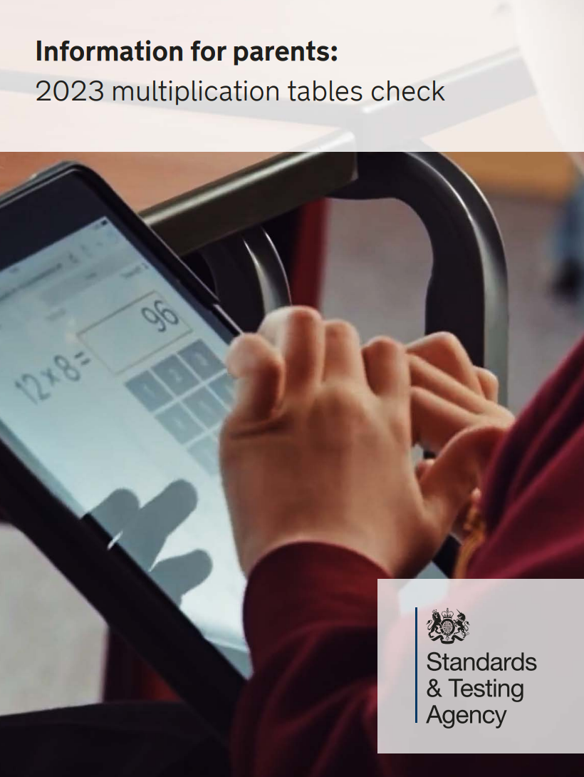
E
Year 4 Statutory Multiplication Check
Year 4 will undertake a statutory Multiplication Tables Check. Tested on tables, up to 12 x 12. in June.
25 questions in total, with the pupils having 6 seconds to answer each question and 3 seconds between each question.

Slide 17


E
Useful Websites
  Multiplication Tables Check
https://www.timestables.co.uk/multiplication-tables-check/

