Slide 1
Welcome to Year 6

Slide 2
Agenda
Overview
Punctuality and attendance
Homework
Home challenges
Knowledge organisers
Reading, Mon, Weds, Fri, logs, 15 min
Computers
Spellings
PE days and swimming
Website
Curriculum expectations

Slide 3
Meet the StaFf
Mrs Haider 6PC
Mrs Baig 6FN
Mr Jurd 6HR
TAs
Mrs Perry
Mrs Fardoos
Miss Mahmood

Slide 4
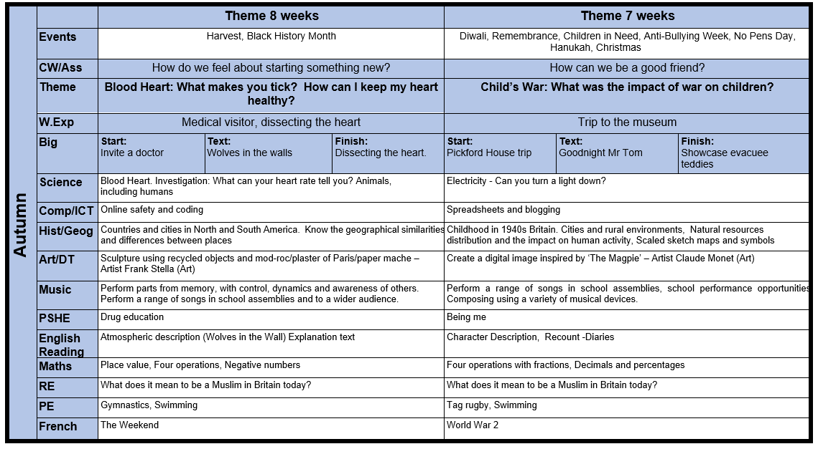

Slide 5
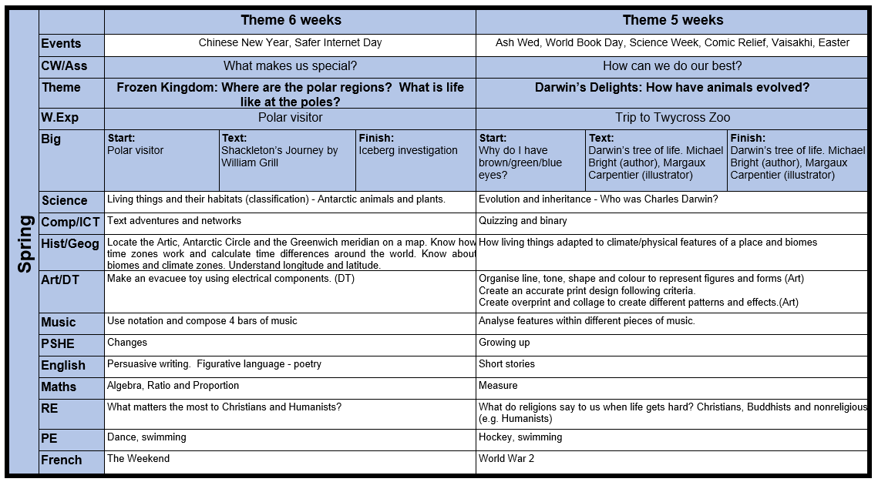

Slide 6
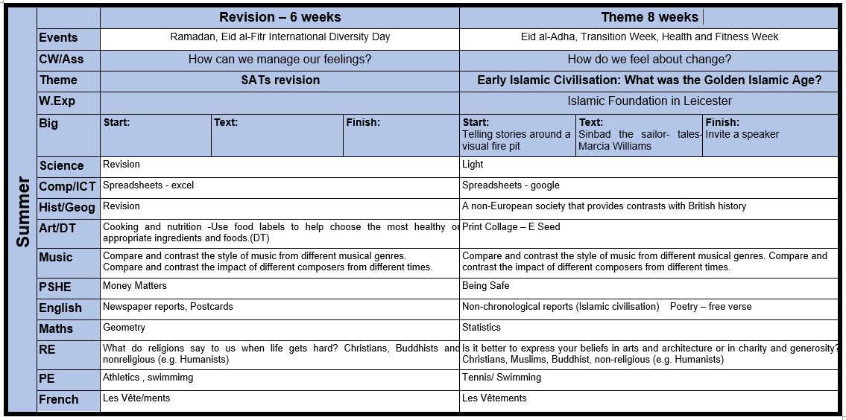

Slide 7
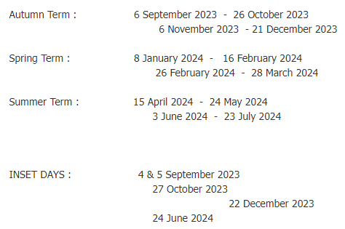
Punctuality and Attendance (Term dates are on the website)

Slide 8
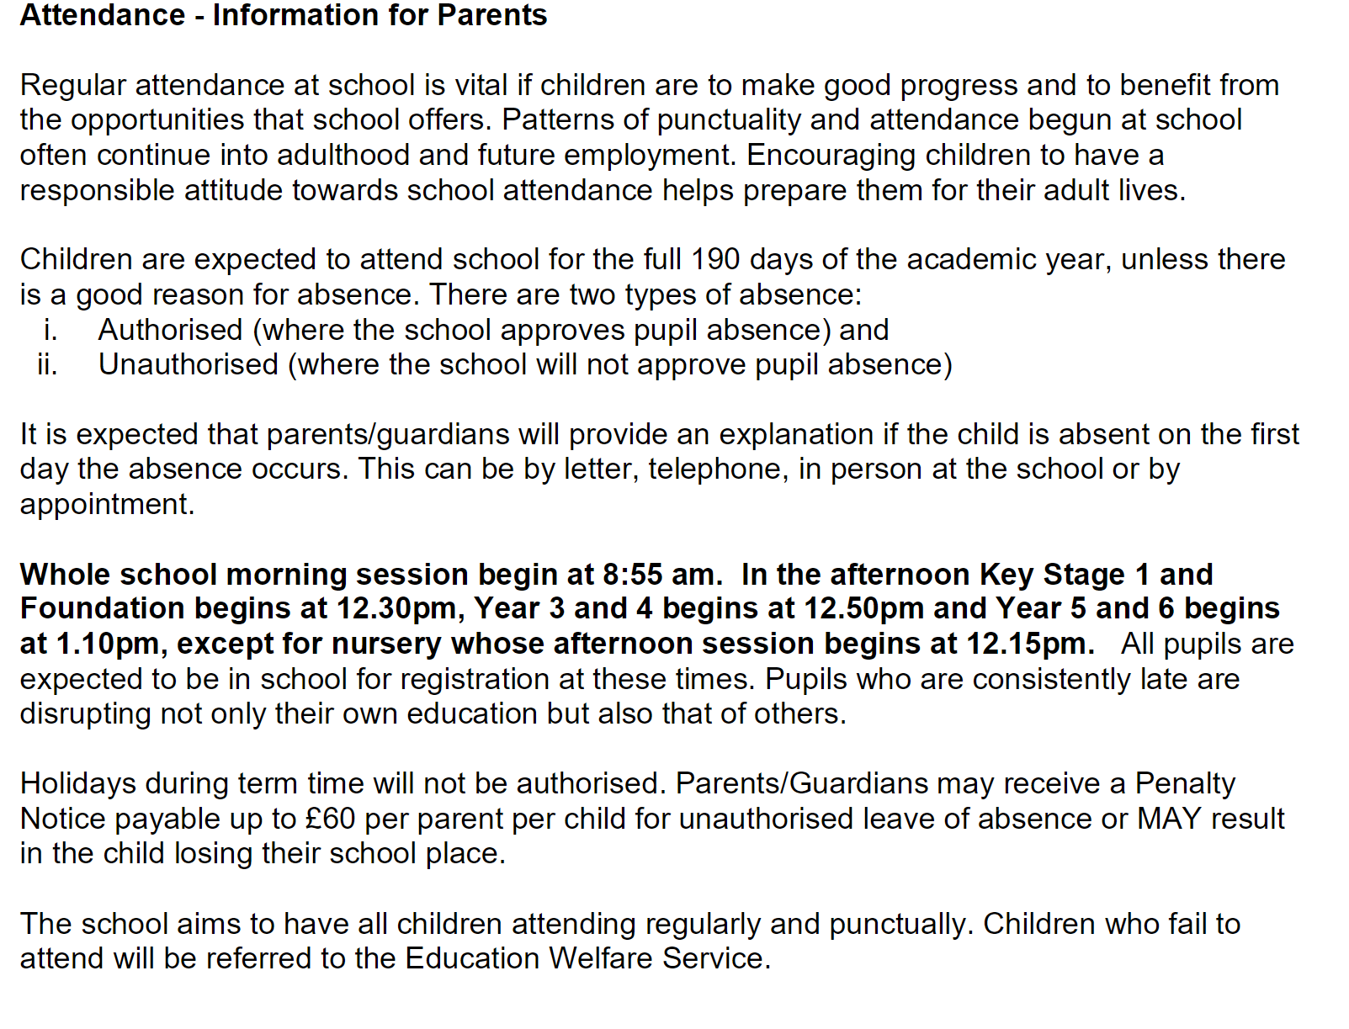

Slide 10
Attendance information for parents
Regular attendance at school is vital if children are to make good progress.
Coming to school encourages children to have a responsible attitude towards school attendance and helps prepare them for adult life.
Children are expected to attend school for the full 190 days of the academic year.
School gates open at 8:40. That’s when learning starts. Children who come to school late will miss out on vital learning.
The school gates lock at 9am. Any children who come after 9am are late for school.
FREE breakfast club for all children from 8:00 in the morning.
Children not collected by 15:30 will need to be picked up from the office (3:30 pm)

Slide 11
Punctuality and Attendance
School gates open at 08:40
Morning session starts at 08:40
School gates close at 08:55 and children who are late need to report to the office
School gates open again at 15:10 (3:10 pm)
Children not collected by 15:30 will need to be picked up from the office (3:30 pm)
FREE breakfast club for all children from 08:00 in the morning.

Slide 13
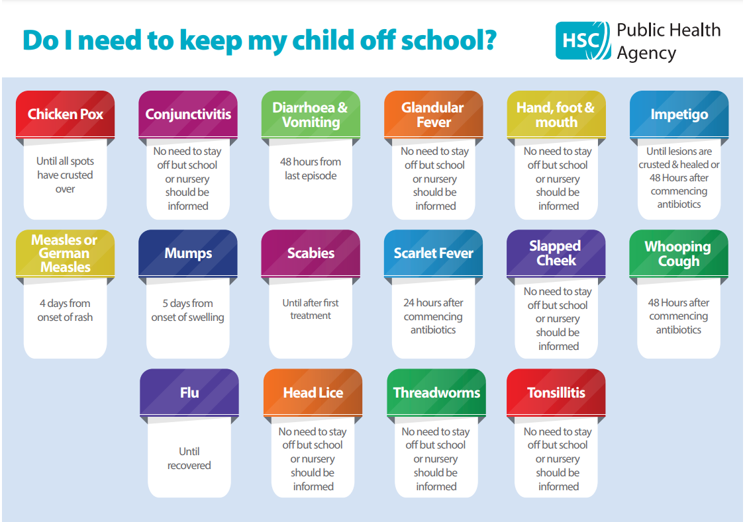

Slide 14
Homework
Homework set on Friday
Returned by Wednesday

Slide 15
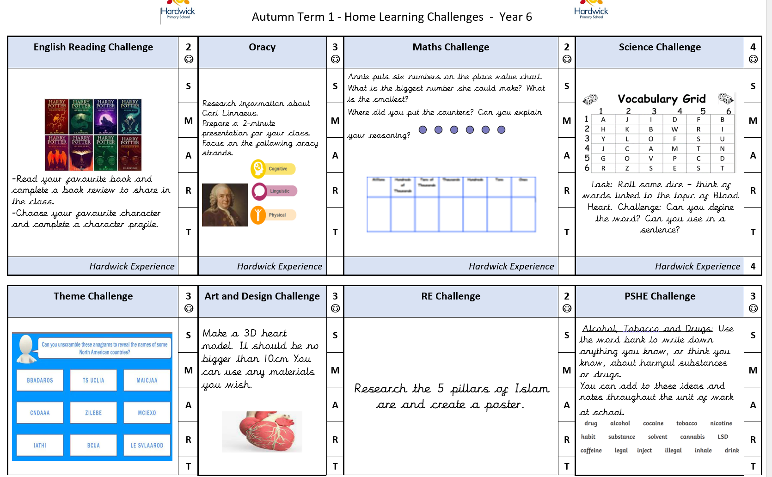

Slide 16
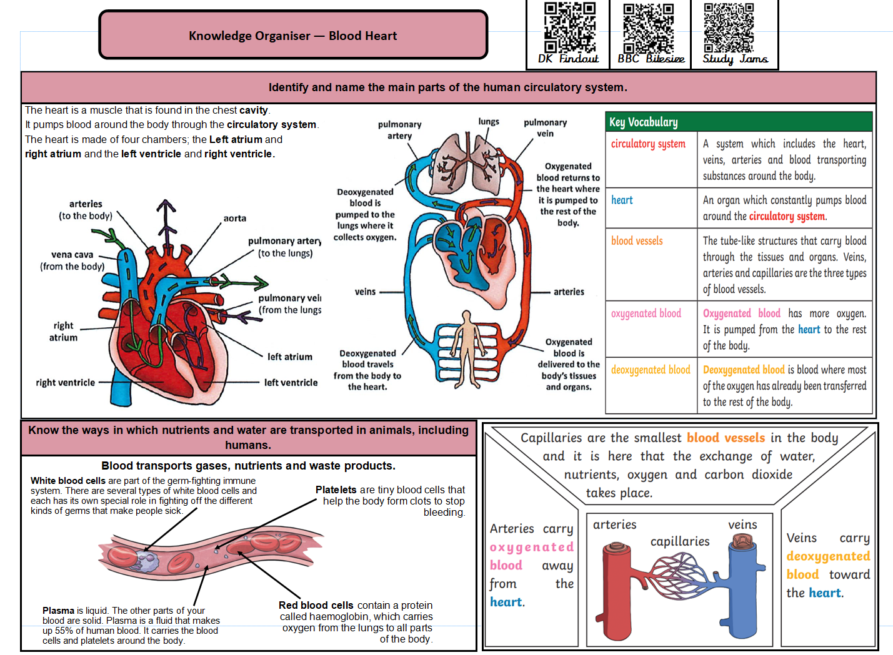

Slide 18
Reading RECORD Stamped
Read three times a week
Checked on Monday, Wednesday, Friday
Read for 20 mins
Sign in reading logs

Slide 19
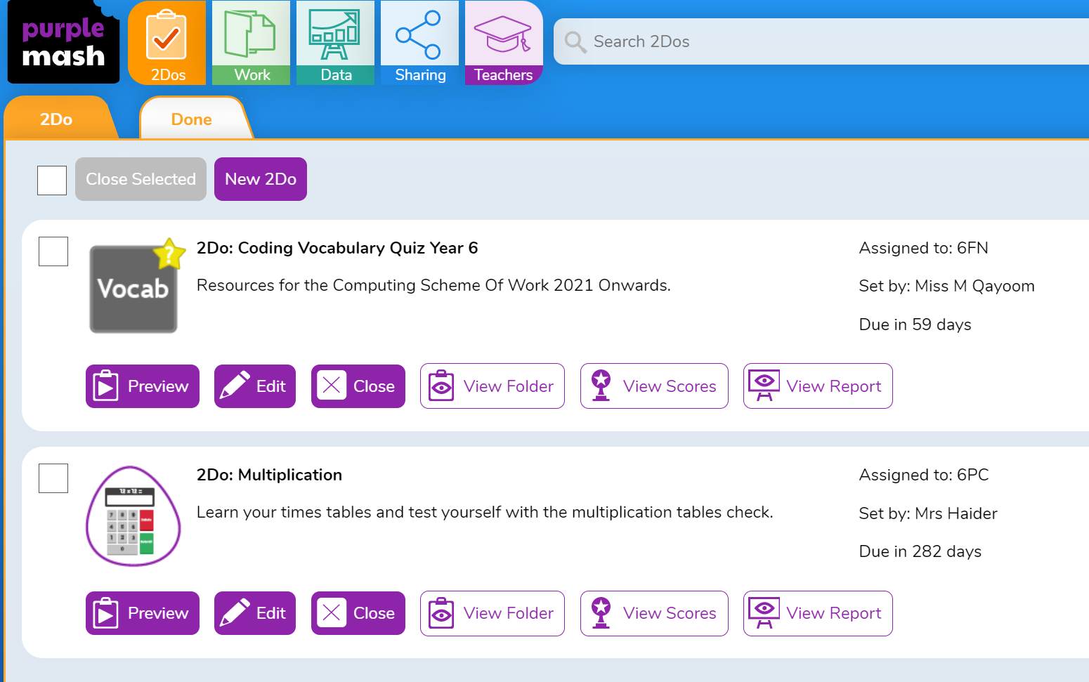
Laptops
Out on Fridays
Returned on Monday

Slide 20
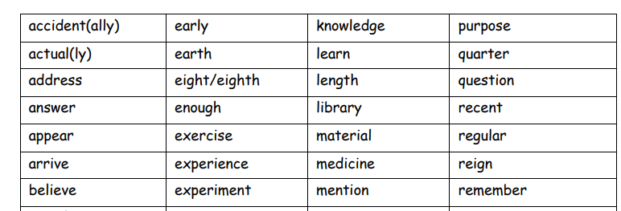
Spellings Homework

Slide 21
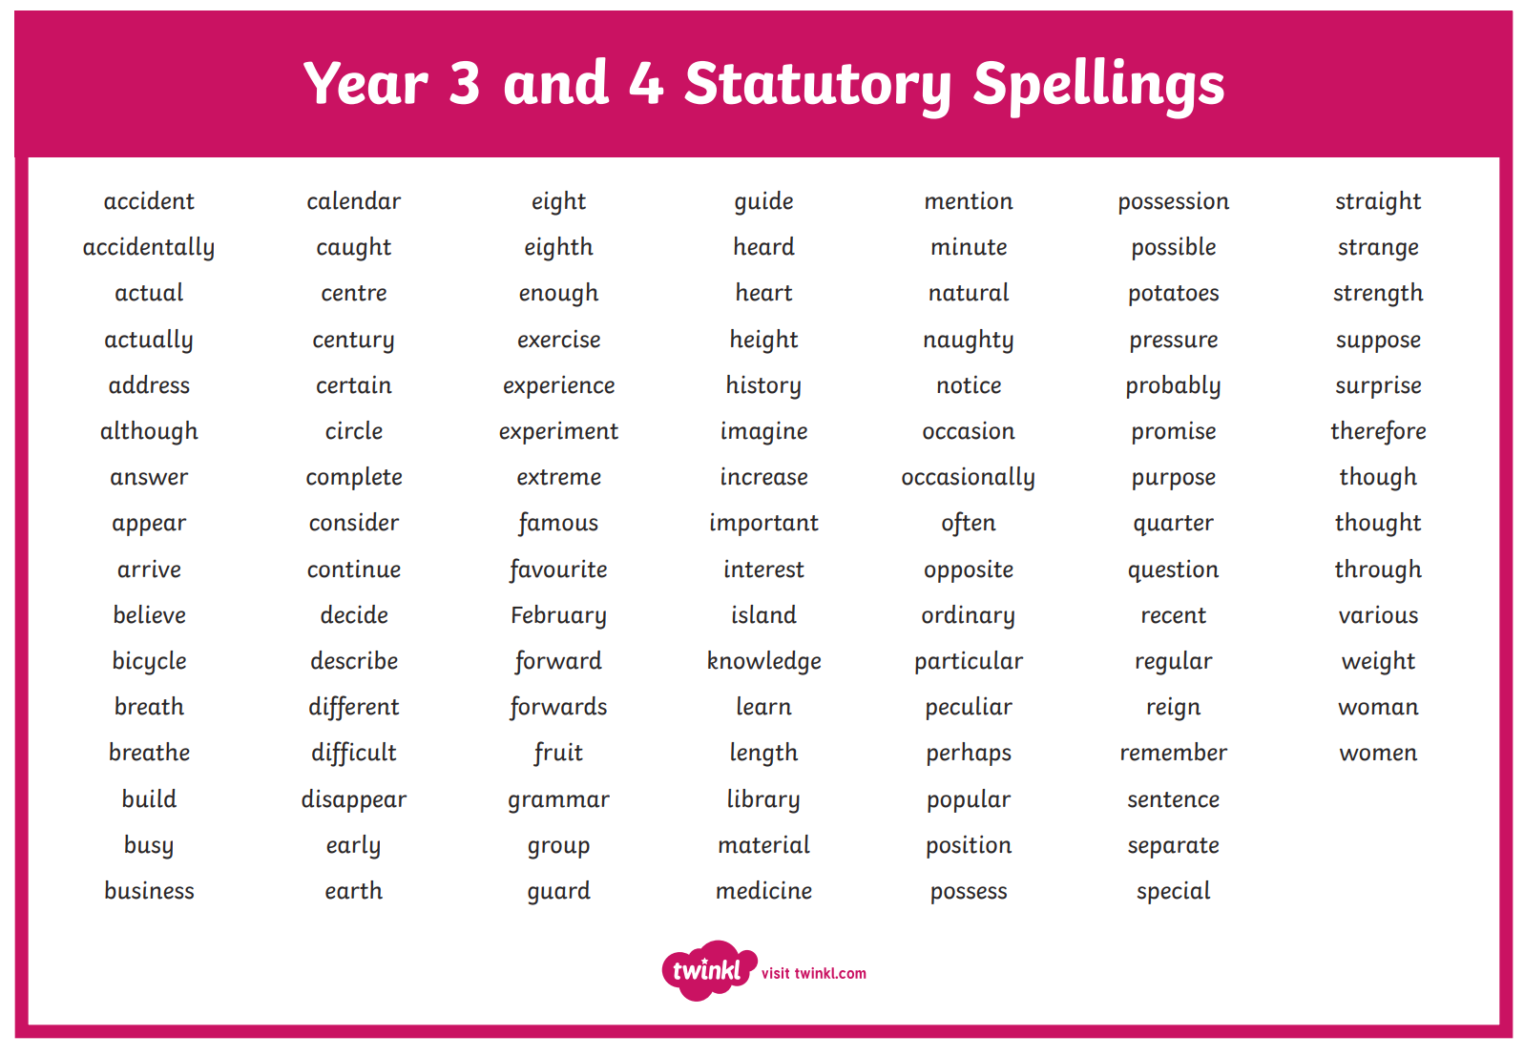

Slide 22
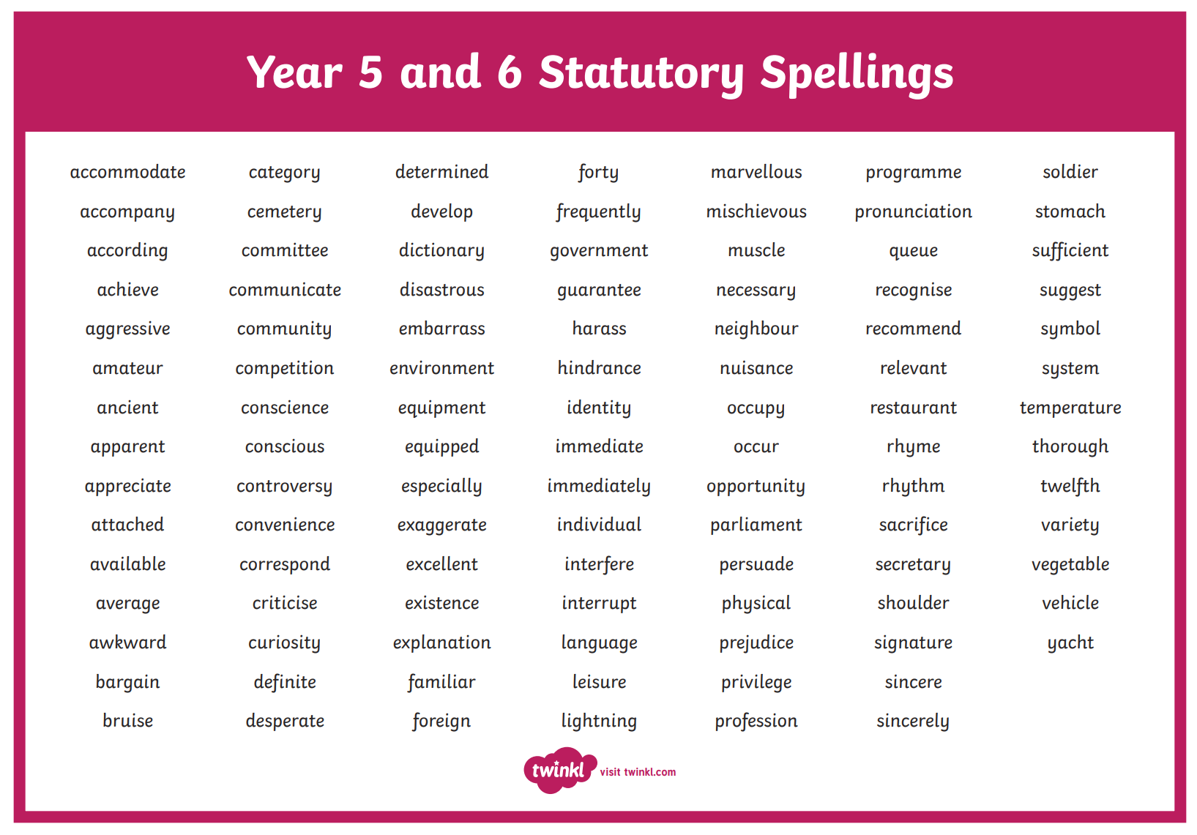

Slide 23
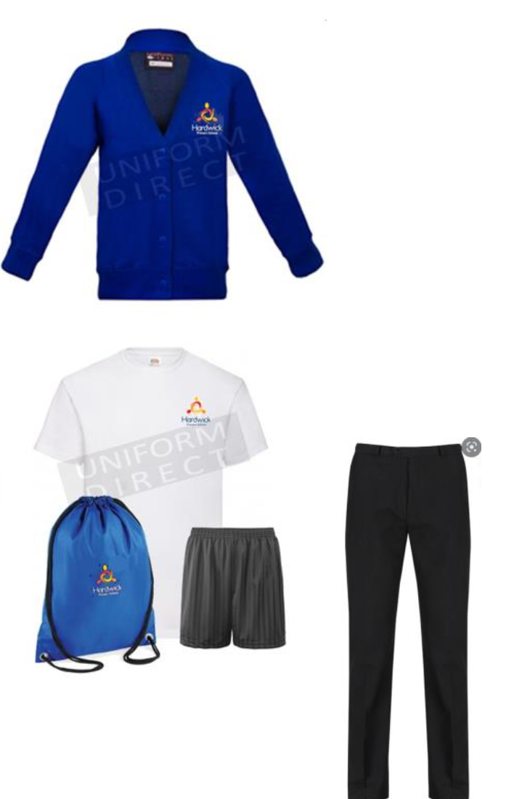
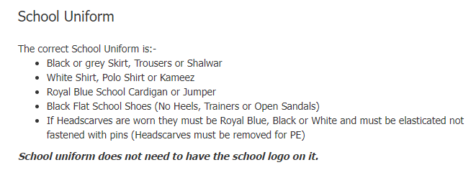
School uniform

Slide 24
Swimming ALL children will get the chance to go swimming this year We are starting with the girls We have a “reserve list” to enable as many children to receive swimming lessons as possible. Cap and Towel Single piece swimming costume (Girls) Above-KNEE PROPER swimming trunks (BOYS)

Slide 25
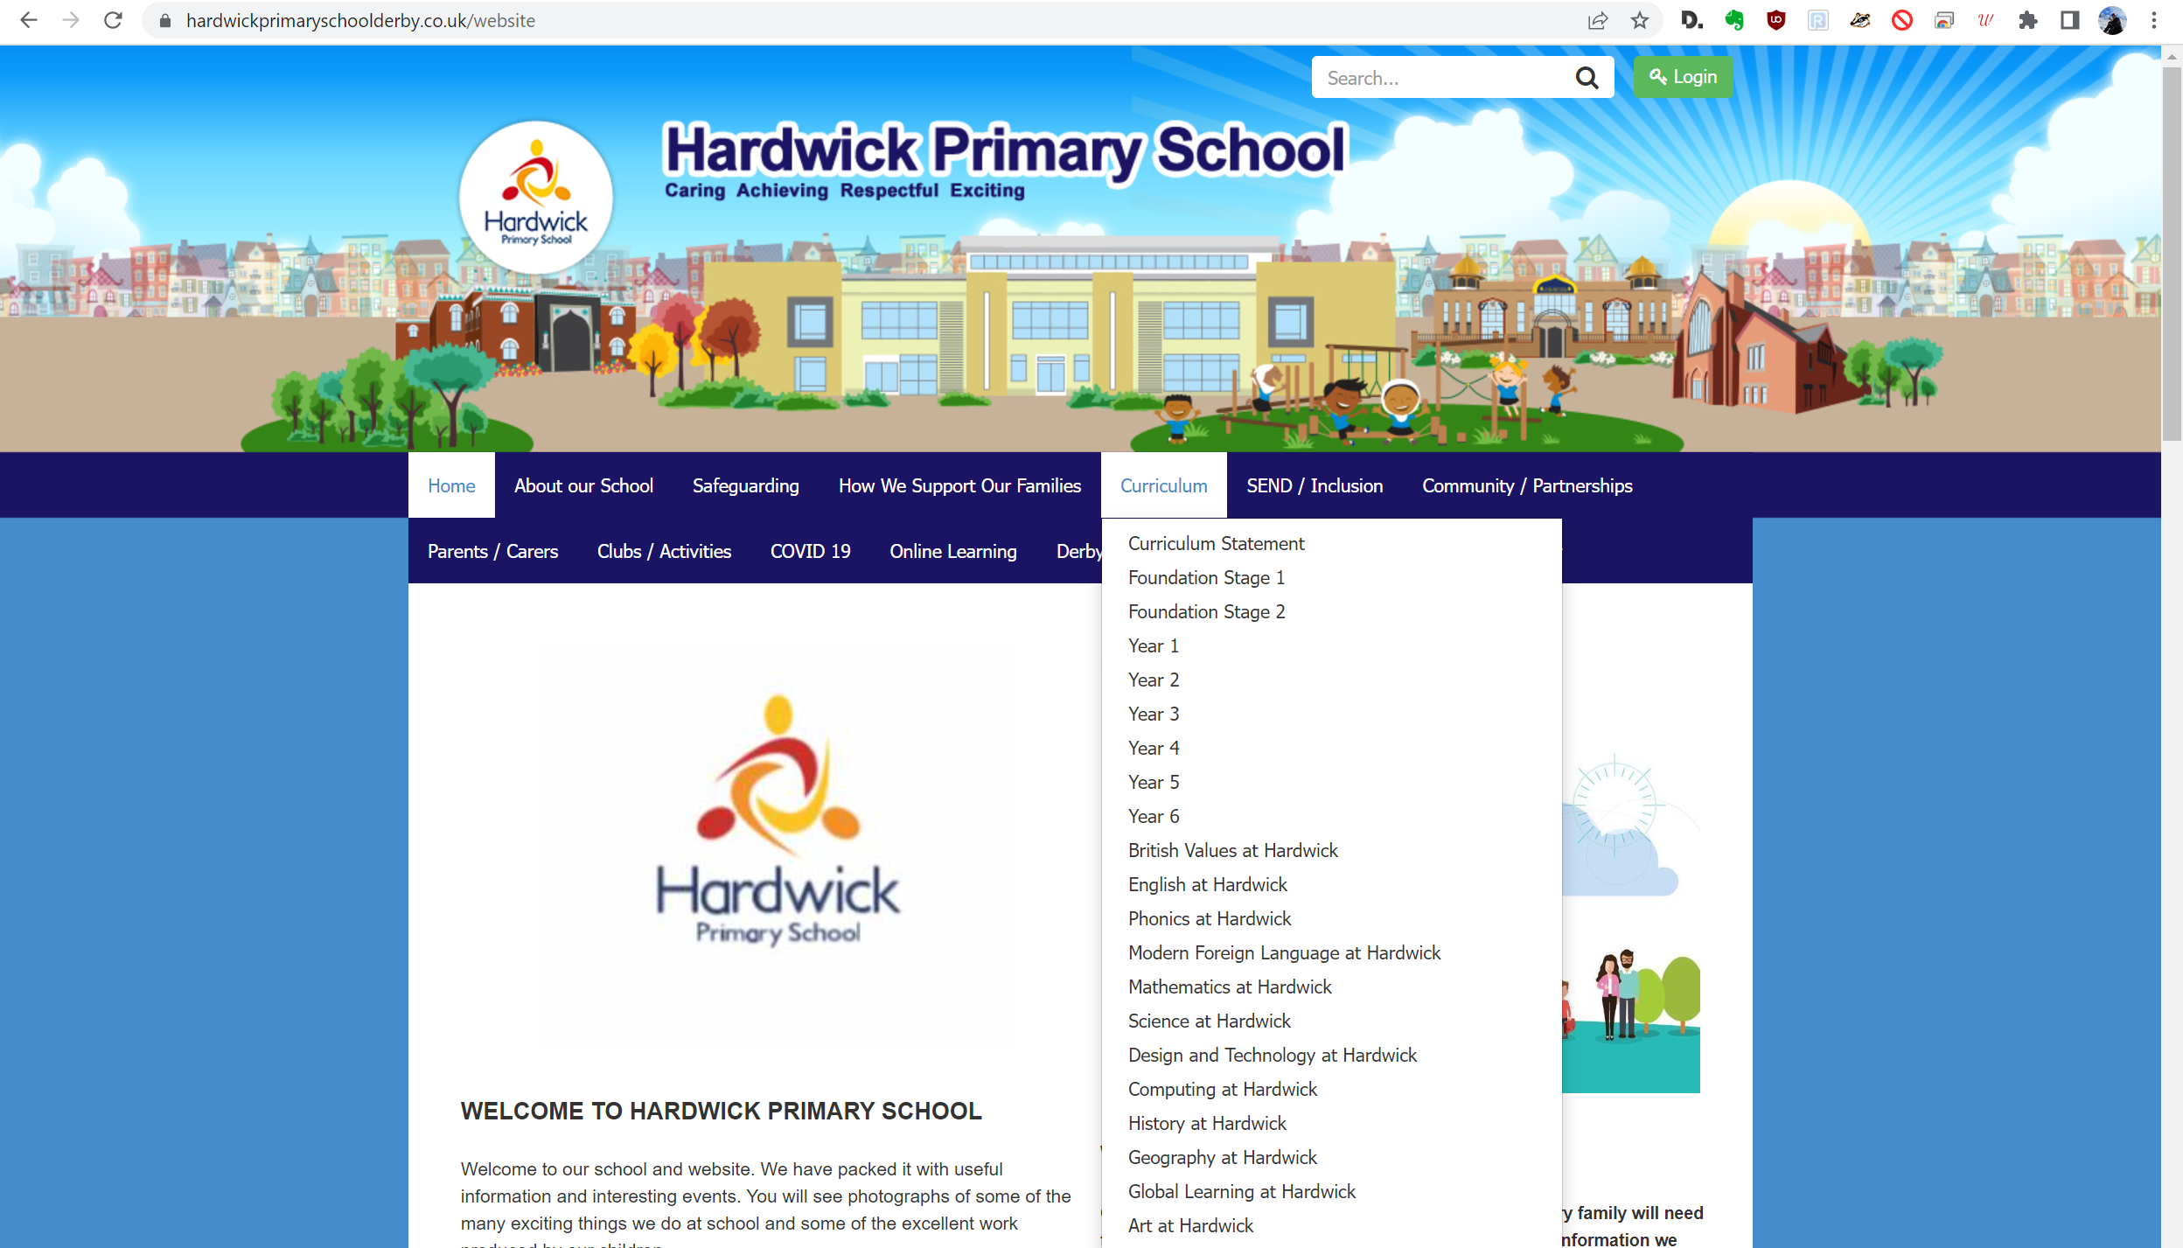
Website
https://www.hardwickprimaryschoolderby.co.uk/website/year_6/181002

Slide 26
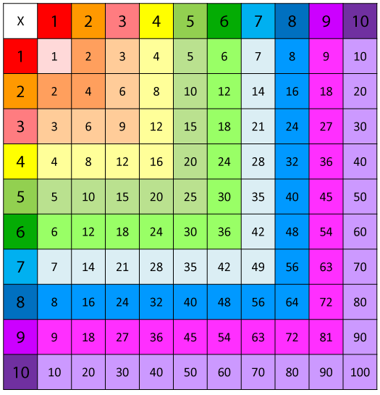
Maths Fluency – How can YOU HELP at home?
X Tables (including division)
Number Bonds
Reading the time

Slide 28
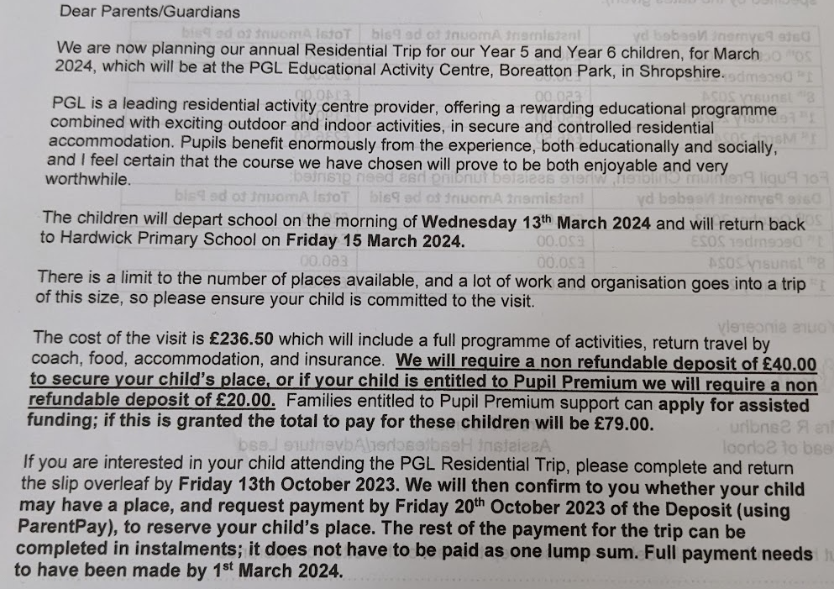

Slide 29
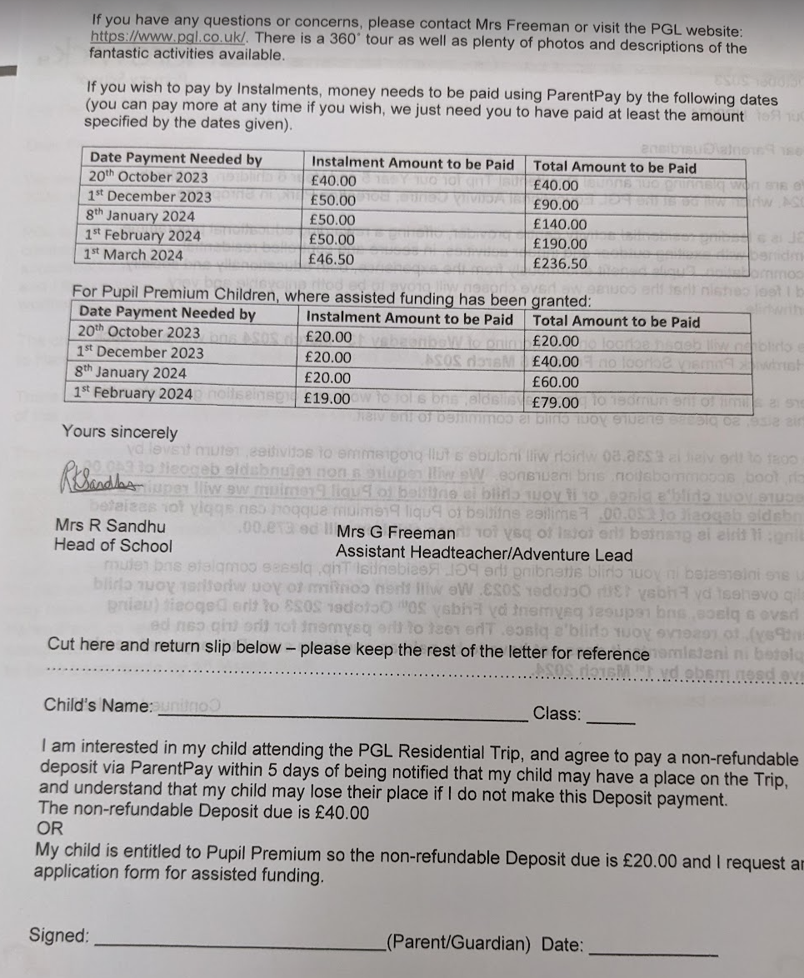

Slide 30
SATS dates
Week of 13th of May 2024
(Half term – 27th May)
(Bank Holiday 6th May)

Slide 31
Summary
Help your child get to school, every day, on time
Make sure your child has the right uniform and PE equipment
Ensure your child knows their times-tables and number bonds
Try to READ with your child AS MUCH AS POSSIBLE

Slide 32
Questions

