Slide 1
Parents Curriculum Workshop
29th September 2023
Reception
Mrs. Maciejewska and Mrs. Gerrard

Slide 2
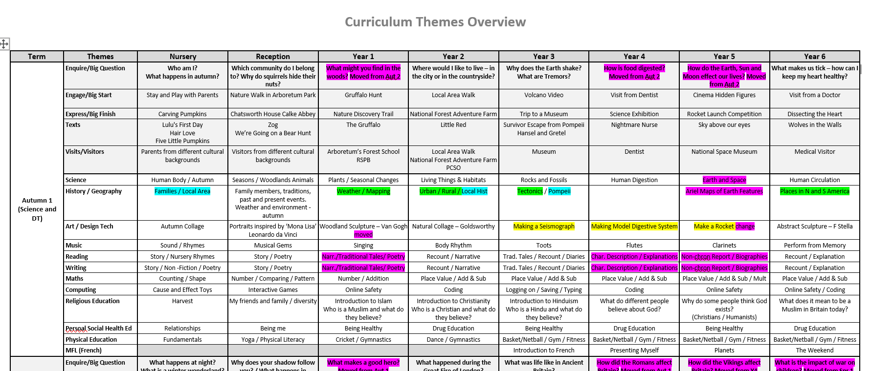
Yearly Overview

Slide 3
Knowledge Organisers

Slide 4
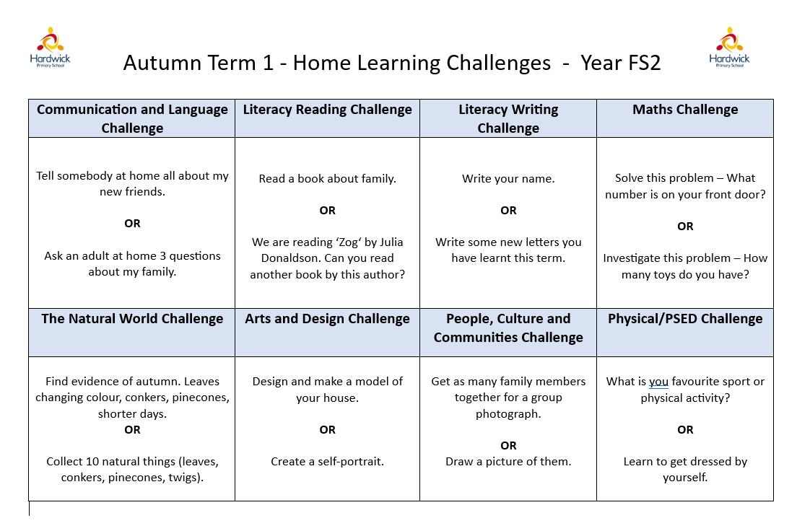
Home Challenges

Slide 5
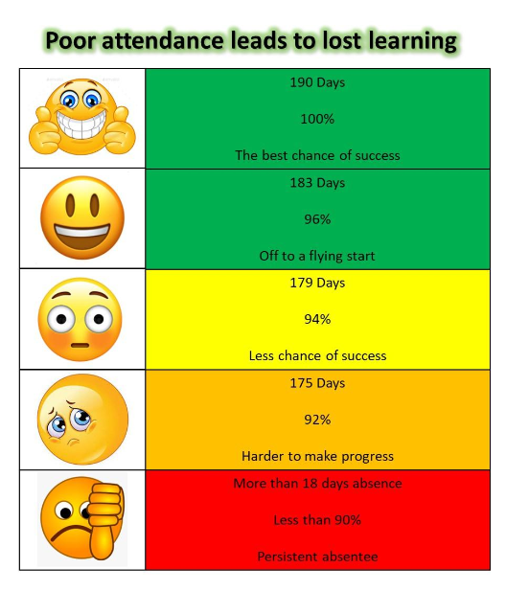
Punctuality
and
Attendance

Slide 6
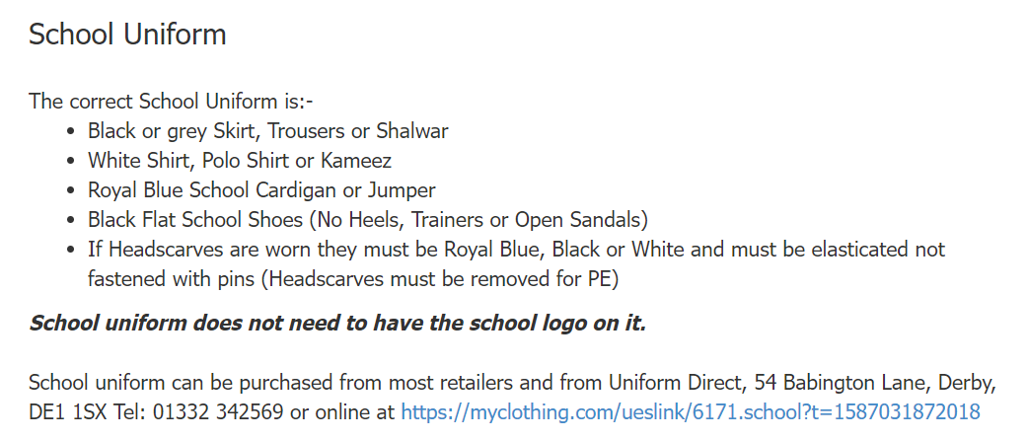
School
Uniform

Slide 7
PE
PE days
Monday and Thursday

Slide 8
Homework
Homework to back on Wednesday
New Homework out on Friday
Bookbag at school every day.
Homework pack:
Homework book
Library Book
Reading Book
New sound sheet

Slide 9
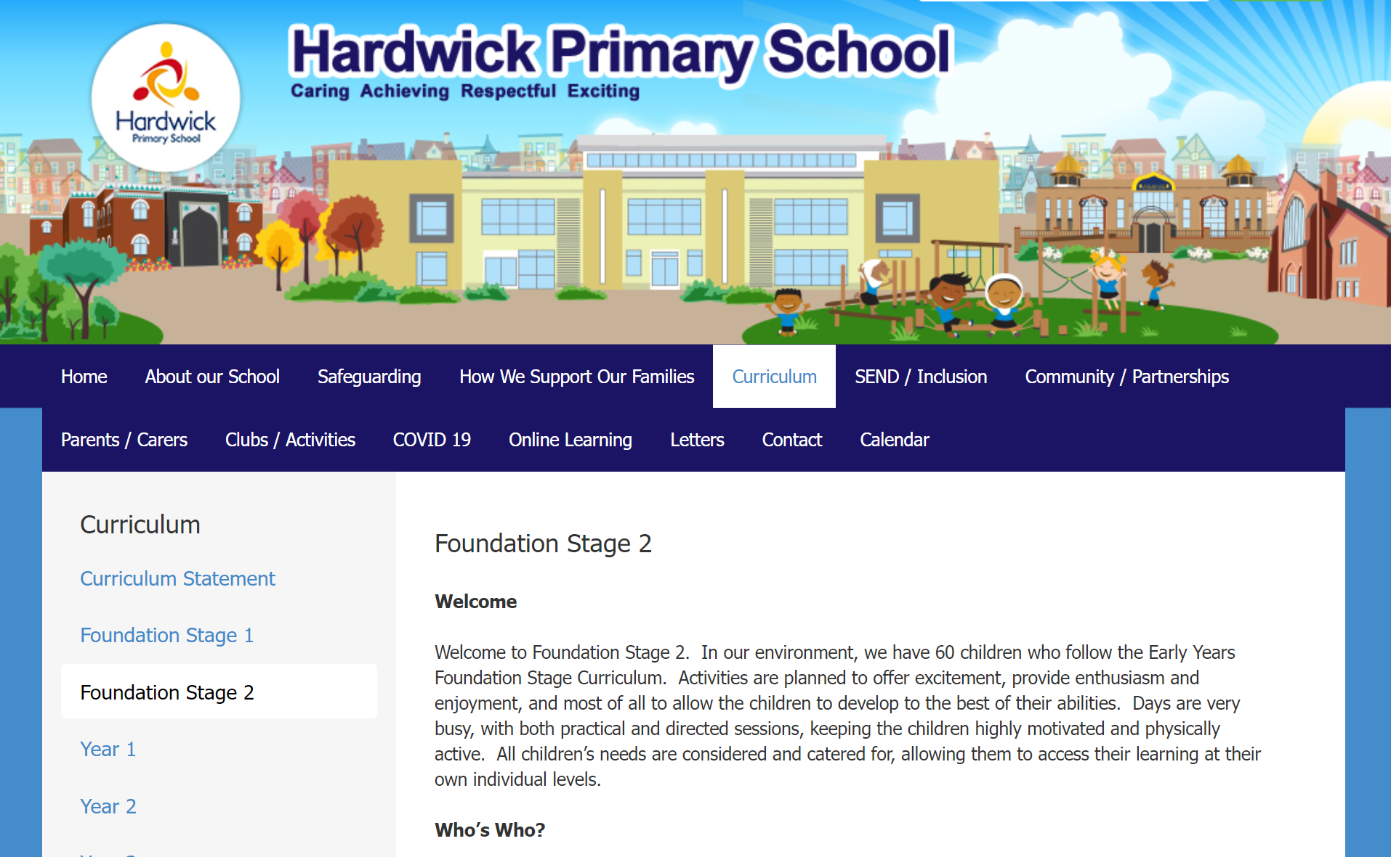
School Website

Slide 10
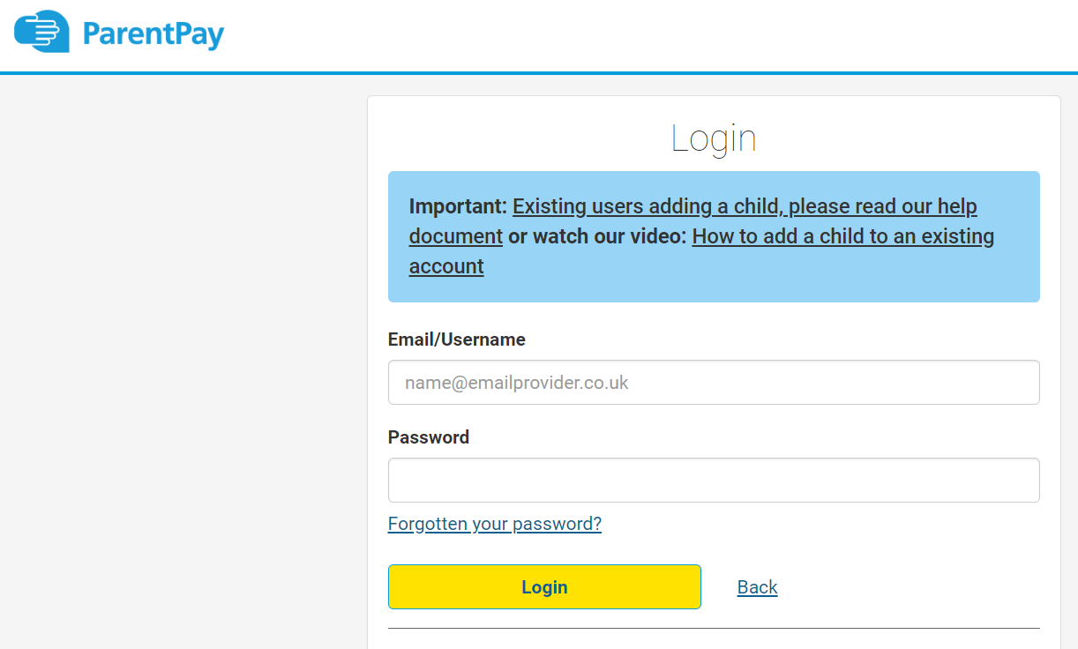
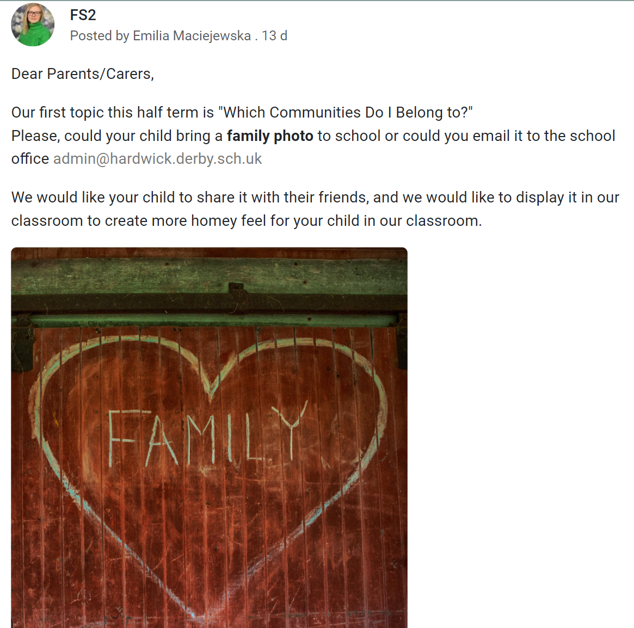
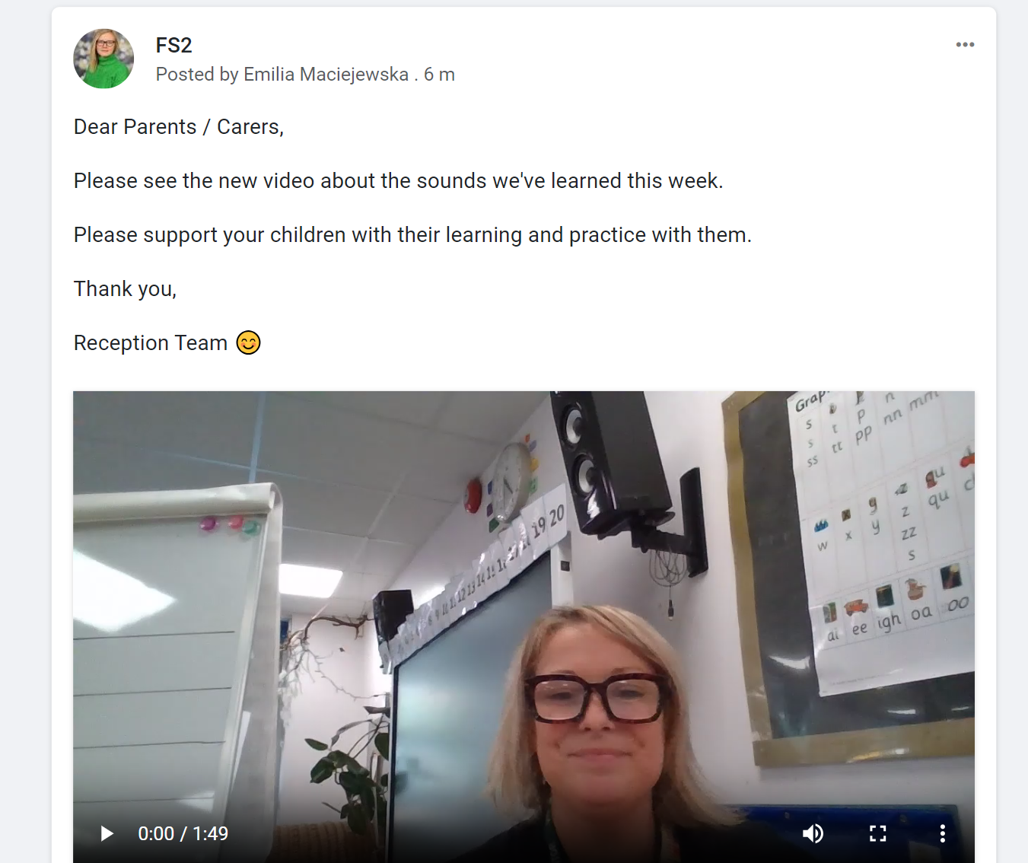
Communication

Slide 11
4th October – RCH morning
RCA afternoon
Upcoming
Trips
13th October – RCA - Calke Abbey
20th October – RCH – Chatsworth House

