Slide 1

Year 5
2023/2024

Slide 2
Meet the year 4 team:
Mrs Tatla, Mrs Hollingsworth and Miss Elton – Class Teachers
Mrs Yar Khan, Mrs Smith, Mrs Loban, and Mrs Thakur – Teaching assistants

Slide 3
Expectations in year 5 at Hardwick:

Slide 4
Attendance Matters
FACT:
‘There is a direct link to higher attainment for those with higher attendance’
Source: ‘Working together to improve school attendance’ DFE

Slide 5
Punctuality
School gates open at 8.45 and close at 8.55.
Children have activities to complete during this time and some children are also listened to read, so it’s important for children to arrive to school on time.

Slide 6
Rewards:
All children can earn smiliey’s for good behaviour and work.
Each week a star of the week is chosen by the staff for an element of our CARE code and they are awarded with a certificate during our good work assembly.
Classes work together to achieve the class trophy at the end of the week.
Classes are awarded punctuality and attendance.
The class with highest attendance over a half term win a popcorn and movie afternoon as a treat.

Slide 7
Homework
Reading minimum of 3x’s a week (Reading record signed)
Times tables Practice to be continued (Purple Mash, TT Rockstars or on paper)
Spellings
Maths weekly homework (Sent on Friday – to be returned on Monday)

Slide 8
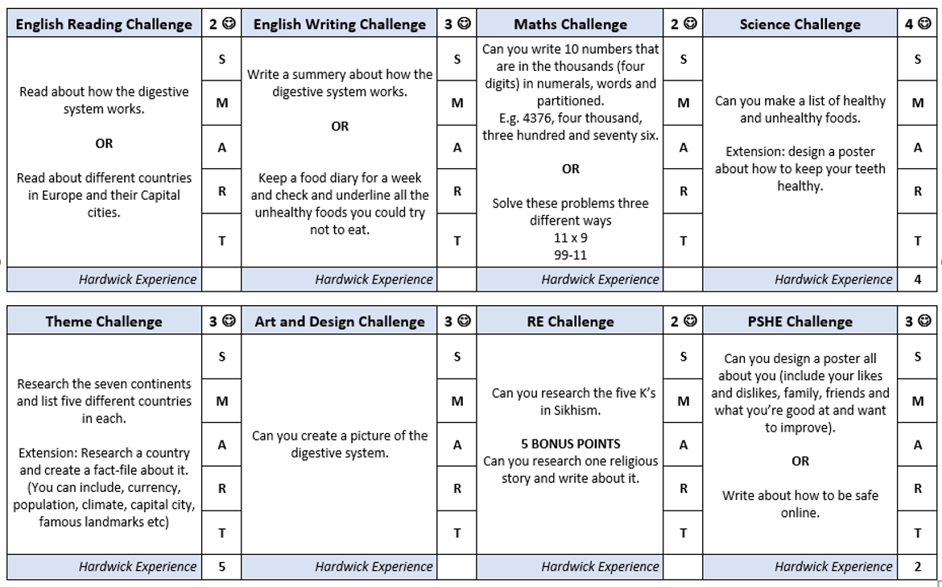
Home Challenges – additional homework

Slide 9
Knowledge organisers
Knowledge organisers are sent home at the end of each term to help the children with their future learning. These outline the key information that the children will be learning over the coming half-term.

Slide 10
PE – Thursday and Friday
Children to continue to come to school wearing their PE kits.
Plain black or navy jogging bottoms or leggings
Plain white T-shirt
Plain black or navy sweatshirt or even their school jumper.
Trainers or pumps

Slide 11
Laptops sent home Friday to be sent back to school on Monday.

Slide 12
TOPICS IN YEAR 5:
Autumn 1 - How do the Earth, Sun and Moon effect our lives? (Science)
Autumn 2 - How did the Vikings affect Britain? (History)
Spring 1 - How do materials change? (Science)
Spring 2 - Who were the Ancient Egyptians? (History)
Summer 1 - Where does our food come from? (Science)
Summer 2 – (Geography / Science)

Slide 13
Thank you!
Any Questions?

